Slide 1
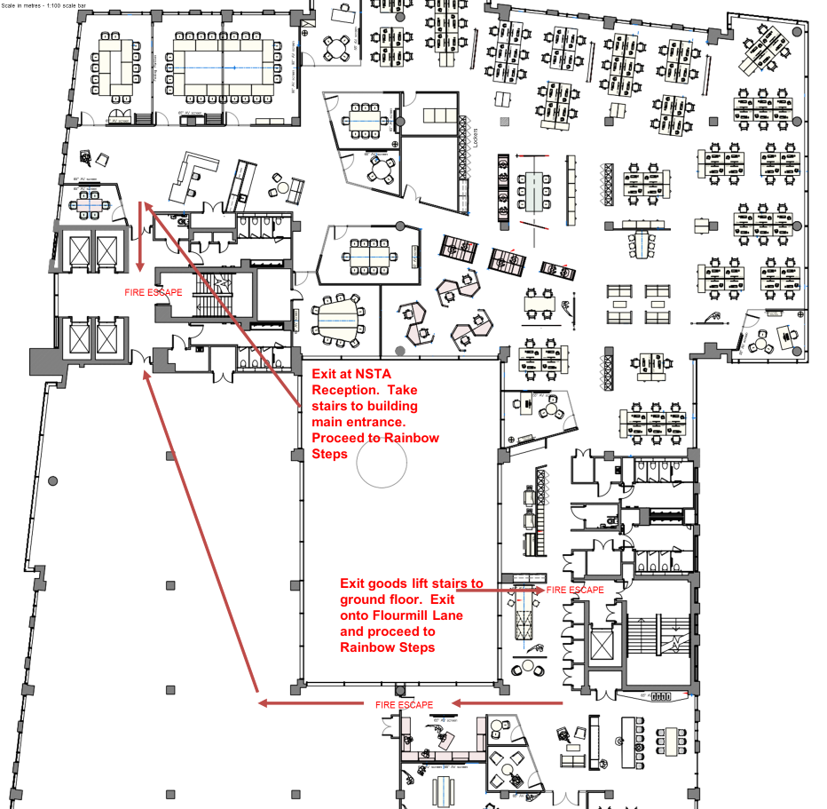
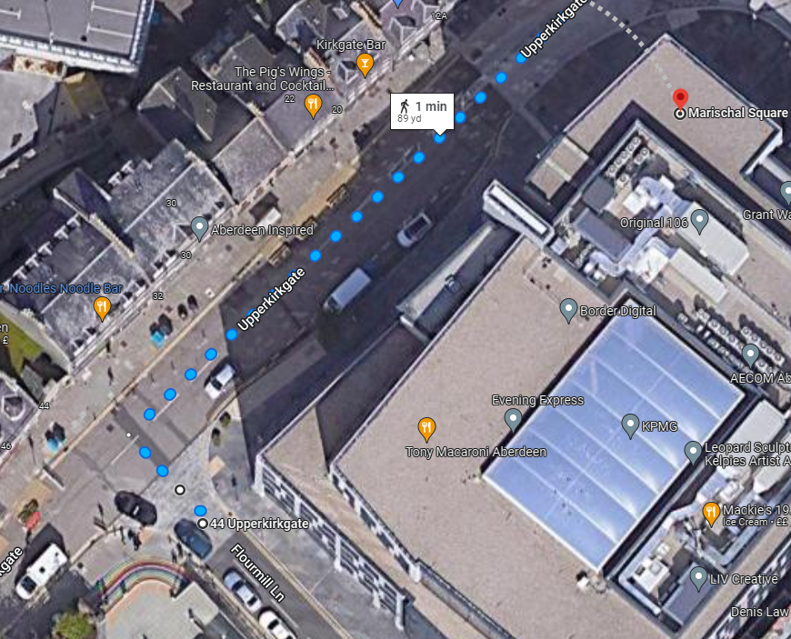
Safety Moment Please take note of the fire exits. The assembly point is the rainbow steps on Flourmill Lane. There is a planned fire alarm test at 12pm.
You are here

Slide 2
UK National Data Repository
User Group Meeting No. 9
27 June 2023

Slide 3
Meeting etiquette & structure
Please turn your cameras off and remain muted.
Please use the meeting chat to post your questions throughout the meeting.
Questions raised in the meeting chat will be addressed at the end of each section of today’s presentation, time permitting.
Please feel free to ask questions at the end of each section of today’s meeting.
Should there be time remaining after all planned sections, we can use that for general discussion.
The meeting will not be recorded - slides to be shared on the NDR User Group web page
https://www.nstauthority.co.uk/data-centre/national-data-repository-ndr/ndr-user-group-and-updates/

Slide 4
Agenda
Introduction and general topics (11:00)
Last meeting – Recap and Activity
General updates: Version releases, Updates to documentation
Task Finish Groups & Projects (11:15)
TFG007 – Legacy Seismic Data Reporting
TFG008 – Data Management Best Practices for Licensees – Inventory Management
TFG011 – User Acceptance Testing – 1 Bit TIFF reporting
Project - NDR Offline Archive – status update
Project - Geophysical Information – Classification Tags
Project - BGS Collaboration - NHDA collection to the NDR
Planned Updates and Developments (11:45) FIRE ALARM TEST (12:00)
Prioritising development work
Resolving issues with NDR metadata
Data Request UIs – C Tags vs Plain language?
Next steps – 3 month outlook (12:15)
Development plan summary
Dates for your diary and Contact information

Slide 5
March meeting – Recap and Activity
Development plan – continuous improvement
Classification Tags for Geophysical information types
Programmatic access (API) to data wellbore – operational
DR and Edit – revised UIs and workflows for NSTA users
Surveys with no geometries (58 projects updated with Licensee information)
NSTA strategic projects
Review of NHDA holdings versus NDR
Review of remaining offline data collection
OCR of legacy data collection (following 2021 PoC)
Enabling data transfer to user’s cloud tenant
Carbon Storage Licences – Information and Samples Consultation response (6th April)
Implications for development of the NDR to accommodate CS Licence Information
https://www.nstauthority.co.uk/media/8999/consultation-on-cs-data-powers_v2-6-april-2023.pdf

Slide 6
Version, documentation and other updates
Version release - v20230613_13 Notice to NDR stakeholders 16.06.23
Functionality - active map layers for offshore wind, carbon storage and geology
Usability - Data Request and Edit Request UI’s for NSTA Reviewers
Reporting - TIFF files at 1 Bit and ‘QC Scan’ for text extraction
Classification Tags - geophysical information types
https://support.uk-ndr.co.uk/hc/en-gb/articles/12050143303570-Release-notes-13th-June-2023
Information Reporting – ‘Form and Manner’ Notice to NDR stakeholders 16.06.23
Table 3 Log Images 1 bit scanned images may be reported for pre 2018 wellbores
Table 3 LAS Header Reflecting the requirement to include Well ID
Table 4 Core Photos information type correctly associated to CORE_CCA
Table 15 Additions to Geophysical information type C Tags as presented at the last meeting
Table 15 Addition of file format SEG-D-GZIP as a compliant format for legacy field seismic data
https://www.nstauthority.co.uk/media/9094/information-reporting-form-and-manner-for-ndr-june-2023.pdf

Slide 7
Q&A
General topics

Slide 8
Task Finish Groups and Projects

Slide 9
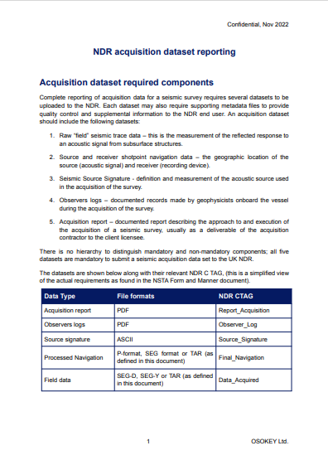
TFG007 - Legacy Seismic Reporting…
Streamline reporting of legacy acquisition data:
to enable elective reporting of such data by licensees,
to establish an archive of accessible and reusable data
Status:
Archival methodology devised
Initial meeting (December) – discussion with licensees
NSTA review of offline archive identified candidate test data sets
Development of archival code and process
NDR team testing and iterative development ongoing
NSTA to re-engage with TFG participants when the solution is further developed

Slide 10
TFG008 – Best Practices: Managing the Inventory
Workshop 25th April
Outcomes & Actions
More Information
1 hour workshop for Data Managers, representing five UKCS licensees
Overview of the Inventory UI
Purpose and functionality
Who can update Inventories?
How to update?
Why and when to update?
User feedback:
What is the logic for ordering of C Tags in UI?
Can this be re-ordered or grouped?
Visibility of Comments
Development log, item #123
(Data Request UI agenda item)
Drop down “Guidance” notes within the UI
Support articles from our Support Centre
Release notes: updates to Inventory UIs December 2022
NDR Support Centre for advice or email ndr@nstauthority.co.uk
Digital, Accessible, Validated and Improved

Slide 11
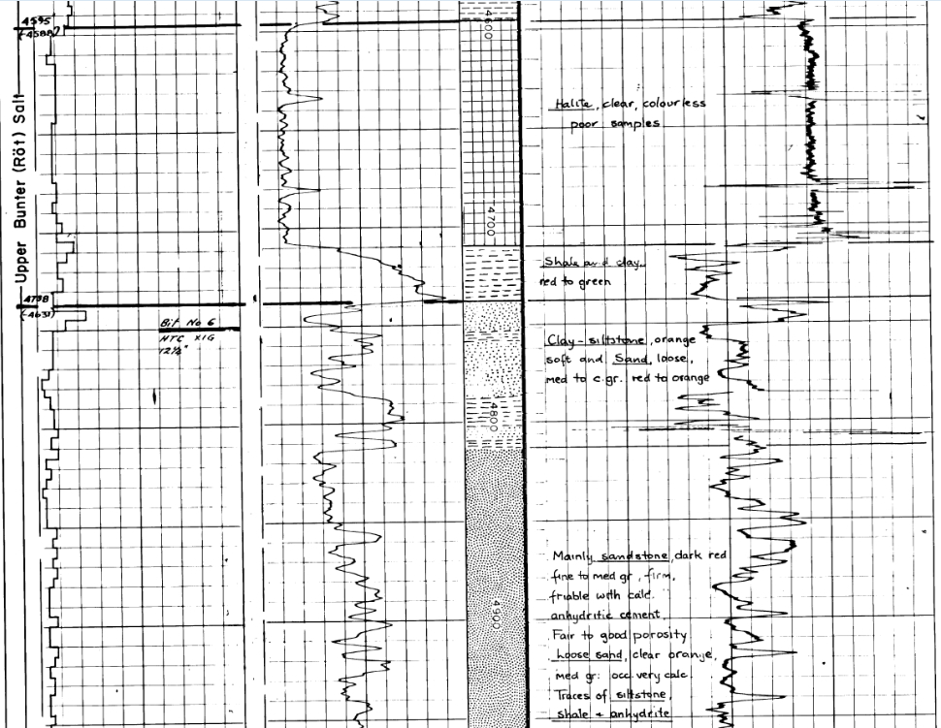
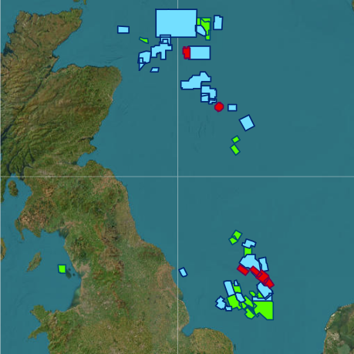
TFG and Activity summaries
TFG011 - 1 Bit TIFF UAT
NDR Offline Archive
Geophysics - C Tags
UAT for upload of 1 Bit TIFFs
Log Image information
Pre 2018 wells
Images recorded at 1 Bit
QC Scan for all TIFF files
% score to indicate success of future text extraction
1,173 individual media items
Tape, Hard drive, DVD, CD
Identify gaps and overlaps
Roughly half are 3D field data
Of which, 60 of 71 now online
Planning for and acting on the remaining data sets
Better differentiation of information
SEG-D archive artefacts:
Coverage Plot, Line listing, Source Signature
Navigation files:
Raw Navigation (P2) and Final Navigation – “Ends and Bends”
Future re-classification exercise

Slide 12
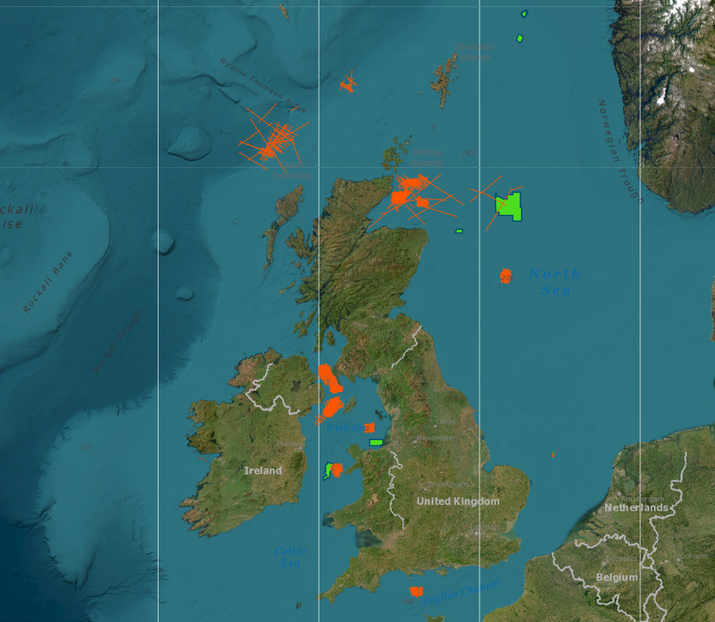
National Hydrocarbons Data Archive
What is the NHDA?
What is in the NHDA?
What are we doing?
NDR precursor run by BGS
Enabled data reporting and relief of obligations to retain
Enabled access to petroleum licence information
Submissions suspended in 2016 when ‘OGA’ announced plans to implement NDR.
Offshore Petroleum licence Information for:
28 x 2D & 7 x 3D Surveys
(Field, Processed, Ancillary)
109 wells – over 7,000 items
Copies provided to NSTA by BGS for review and action
NSTA & Moveout review of NHDA collection
Compare existing NDR collection
Uploading seismic not yet in NDR
Well data file level analysis
Decision to be taken for all items

Slide 13
Q&A
Task Finish Groups and Projects

Slide 14
Forthcoming updates and developments

Slide 15
Developments – Prioritisation of work
Ideas and suggestions for NDR related development work are logged by the NDR Team
As for everyone, our resources are limited – be they time, people, money or otherwise.
Developments need to be prioritised and justified before we commit resources.
We need to be mindful of the purpose of the NDR and what it aims to enable before making decisions.
Considerations include: Complexity
Impact on Compliance with regulatory reporting obligations
Impact on access to data for NDR users
Impact on user experience
Cost
High complexity, relatively costly developments that enable regulatory compliance are likely to be prioritised over suggestions that lead to marginal improvements in UX.
Ultimately, there needs to be a credible ‘business case’ to justify commitment of resources.

Slide 16
Issues to resolve – NDR data and metadata
Examples of issues in NDR data and metadata that need to be addressed
Offline data archived to NHDA
Review the classification of Navigation
Standardise and correct File Format metadata (legacy)
Correct population of ‘Release Rule’ attribute (legacy)
Surveys with invalid CRS (legacy)
Non machine readable content (legacy)
Surveys without geometries (legacy)
Wells without projects
Surveys without projects
esp. Site Surveys
Offline data reported to NSTA (legacy)

Slide 17
Resolving metadata issues: Format Labelling
Incorrect File Format label: 84,305 files labelled as LAS (9th June 2023)
636 files labelled as LAS with a suffix other than .las
203 are suffixed “.txt”
161 are suffixed .asc, .ascii etc.
102 are suffixed .pdf
42 are suffixed .zip
28 are suffixed .xls, .xlsx, .xlsm (!)
Elsewhere, “.LAS” files labelled: ASCII (300) DLIS (73) PDF (51) (Blank) (39)
WELL (33) LIS (25) PDS (3) MS WORD (2)
CGM (2) TIFF (1) At least 529

Slide 18
Resolving metadata issues: “LAS” files
Rank | Count | File Suffix | Action | Comment
1 | 203 | .txt | Relabel File Format as PLAIN / No Action yet | 31 x WDD_FILE
2 | 161 | .asc (& .ascii etc.) | No action at this time. | Possibly LAS format
3 | 102 | .pdf | Relabel File Format as PDF
4 | 42 | .zip | Relabel File Format as ZIP | Non compliant format
5 | 27 | .xls (& .xlsx, .xlsm !) | Relabel File Format as MSEXCEL | Non compliant format
6 | 23 | .jpg | Relabel File Format as JPEG
7 | 21 | .dlis | Relabel File Format as DLIS
8 | 9 | .tiff | Relabel File Format as TIFF
9 | 4 | .bin | Relabel File Format as INVALID | Compliance review
10 | 3 | .pds | Relabel File Format as PDS
18 files labelled as LAS are saved to other non compliant formats (.ver .meta .rar .xml .bhi .a5 .nti etc)
Over 84,000 File Format labels need to be corrected (across multiple data types – roughly 10%)

Slide 19
Q&A
Developments – Corrections to File Format

Slide 20
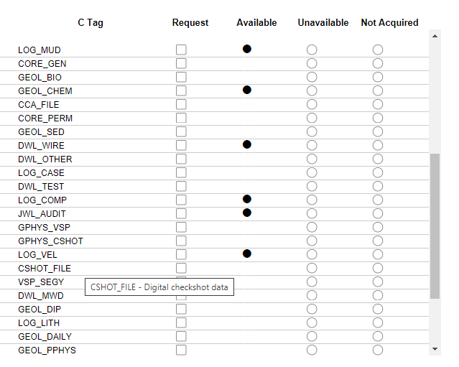
Data Request UI - C Tags or Plain text
The Data Request User Interfaces (UIs) list all reportable information types for wells, seismic surveys and site surveys
Information types are presented according to their associated “Classification Tag” (C Tag)
Classification Tags are convenient shorthand, applied by Licensee Data Managers
Familiar to those who report data – less so to non Licensee users?
NSTA experience of Data Request behaviours of non Licensee users suggests that such users don’t “speak the lingo”

Slide 21
Data Request UI - C Tags or Plain text (Examples)
Information Type
Mud Log, FEL, PEL
Core Operations Report
Biostratigraphy, palynology report
Geochemistry report
Conventional Core Analysis data
Core Permeametry report
Sedimentology, petrology report
Digital Wireline Log data
Other wireline log data
Casing log / Tubing log
Well Test data
Composite well log
Joined well log audit document
VSP report
Checkshot report
Velocity log, seismic calibration log
Digital checkshot data
VSP data (SEG-Y)
CSHOT_FILE
LWD / MWD Log data
Dipmeter/borehole imaging report
Lithological log data
Daily geological observations report
Petrophysical end of well report

Slide 22
Results of User Feedback During the Meeting

Slide 23
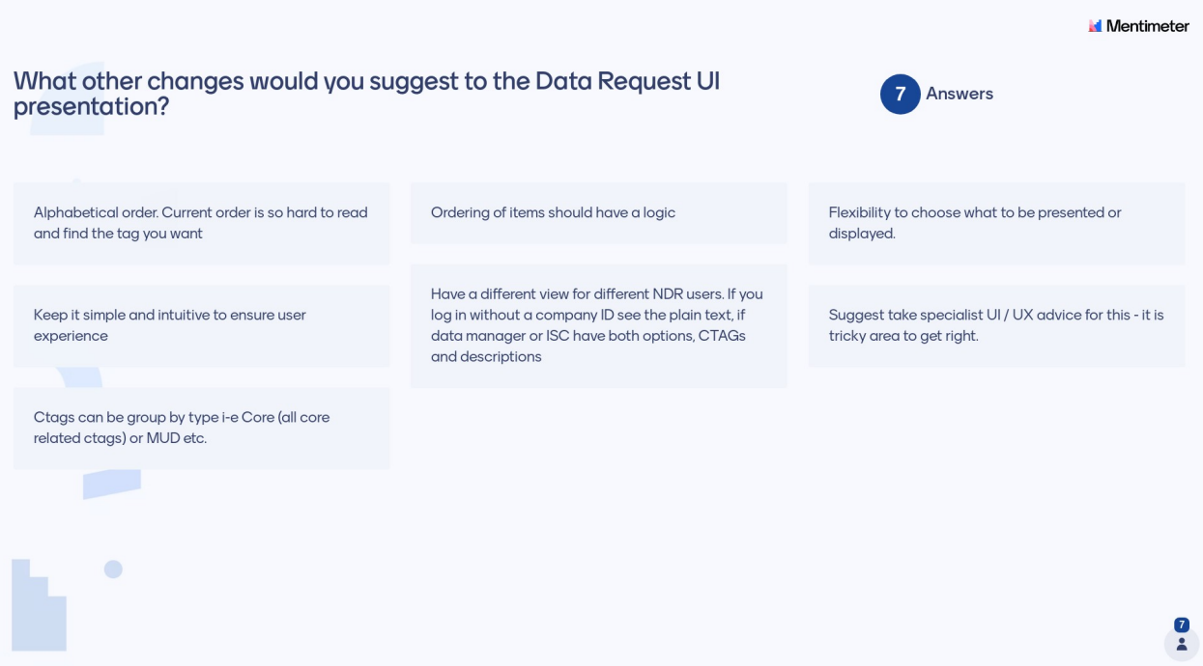
Results of User Feedback During the Meeting (2)

Slide 24
Q&A
Developments – C Tags or Plain Text?

Slide 25
Next steps

Slide 26
Next steps – 3 month outlook
Active Projects
SEG-D archive procedure – development and testing
NHDA archive to NDR - seismic and well information
Offline archive to NDR (continued)
Under consideration/planning
File format label corrections
Data Request UI developments (accounting for user feedback)
Seismic survey metadata to NSTA Open Data
Seismic navigation data review

Slide 27
Dates For Your Diary
Month | Date | Event | Participants
September | Tue 12 | NDR User Group Meeting 10 (online) | All NDR Users
November | Tue 14* | NDR User Group Meeting 11 (hybrid) | All NDR Users
March | Tue 12* | NDR User Group Meeting 12 (online) | All NDR Users
 | TBC | TFG007 – Review: Legacy Seismic Reporting | Data Reporting Licensees
*Provisional date

Slide 28
Contact Information
NSTA NDR Team
NDR Team - email our mailbox ndr@nstauthority.co.uk
General enquires in relation to the National Data Repository
Referrals to NSTA colleagues or Support Centre, where appropriate
Register for the NDR User Group mailing list – updates and User Group invitations
NDR Support Centre
Technical support for matters in relation to using the National Data Repository
Advice on how to use the UI, uploading data, downloads, ordering on media, metadata services
Osokey and Moveout technical expertise
support@uk-ndr.co.uk
https://support.uk-ndr.co.uk/
in app Support Centre launch – raise tickets, support articles and video explainers
Support Centre chat option

Slide 29
Thank You

