Slide 1
UK National Data Repository
User Group Meeting No. 8
28 March 2023

Slide 2
Meeting etiquette & structure
Please turn your cameras off and remain muted.
Please use the meeting chat to post your questions throughout the meeting.
Questions raised in the meeting chat will be addressed at the end of each section of today’s presentation, time permitting.
Please feel free to ask questions at the end of each section of today’s meeting.
Should there be time remaining after all planned sections, we can use that for general discussion.
The meeting will not be recorded - slides to be shared on the NDR User Group web page
https://www.nstauthority.co.uk/data-centre/national-data-repository-ndr/ndr-user-group-and-updates/

Slide 3
Agenda
Introduction and general topics (11:00)
Last meeting – Recap
General updates: Version releases, Updates to documentation
How To…
Task Finish Groups & Projects (11:15)
TFG006 – Cloud to Cloud seismic data reporting
TFG007 – Legacy Seismic Data Reporting
TFG008 – Proposed - Data Management Best Practices for Licensees
Projects – Internal NSTA workflows and BGS/NHDA Collaboration
Planned Updates and Developments (11:45)
Classification Tags for Geophysical Information
Programmatic access to Wellbore Information
Next steps – 3 month outlook (12:15)
Development plan summary
Dates for your diary
NDR Contact information

Slide 4
November meeting – Recap
Development plan – continuous improvement
Accessibility and general layout of Inventory and Data Request UIs
Data Request workflow and notification changes
Accepting TIFF for legacy Log Image files and revising LAS header validation
NSTA strategic projects
OCR of legacy data collection (following 2021 PoC)
Programmatic access to data
Enabling data transfer to user’s cloud tenant
Licensing Rounds
Offshore Petroleum Licensing Round – closing in January
How did the NDR contribute to your company’s involvement?
Questionnaire (as we did for Carbon Storage licensing) – https://forms.office.com/e/8Pr22Tsh2W

Slide 5
Version, documentation and other updates
V20221216_16 Notice to NDR stakeholders 20.12.22
Accessibility & usability - Inventory, Data Request and Suggest Edit UI’s
Summary information - Project Size calculations
https://support.uk-ndr.co.uk/hc/en-gb/articles/9191967451666-Release-notes-20th-December-2022
V20230203_15 Notice to NDR stakeholders 06.02.23
Data Submission - Uploading Log Images in TIFF format for pre-2018 wellbores
Documentation - Associated updates to the “Form and Manner” document
https://support.uk-ndr.co.uk/hc/en-gb/articles/9976766296082-Release-notes-6th-February-2023
V20230220_16 Notice to NDR stakeholders 27.02.23
Data Submission - LAS file validation by Well Registration ID
Data Classification - Maintenance etc. of Well Reports in TIFF format
https://support.uk-ndr.co.uk/hc/en-gb/articles/10280125553426-Release-notes-27th-February-2023

Slide 6
Version, documentation and other updates.
Documentation:
Form & Manner for NDR: February 2023 update announced 06.02.23
TIFF image Classification Tags – 15 x “LOG_XYZ” C Tags
TIFF image parameters – bit depth, min/max width/length, min/max resolution
Rearrangement of Table 15: Geophysical data classification tags
- to reflect the stages of acquisition and processing of a survey and its data
- aligned to the new layout to seismic project Inventory and Data Request UIs
https://www.nstauthority.co.uk/media/8781/information-reporting-form-and-manner-for-ndr-february-2023-1.pdf
NSTA intends to update the document with:
Validation of LAS format “DWL FILE” file types using Well ID, rather than surface location
Additional C Tags for Geophysical information – related to developments for field data reporting

Slide 7
Q&A
General topics

Slide 8
How To…
Link to BGS Core Photographs

Slide 9
Video:

Slide 10
Task Finish Groups and Projects

Slide 11
TFG006 – Cloud to Cloud Seismic Reporting
Initiated summer 2022 - NDR Team approached a short list of licensees
Significant holdings of legacy and current seismic data
Thought to be hosting seismic data in cloud based systems
The conditions exist for licensees to report data directly from their cloud systems to the NDR
We expect there are efficiencies to be had from direct data transfer – time and/or costs
We don’t know for certain – we don’t have visibility of licensee systems, commercial arrangements with suppliers etc.
If there are ways to leverage technology to enable efficient, effective and less costly reporting, then we’d like to see them being used
Further to discussions and limited uptake, the proposal is to close this group
Contact ndr@nstauthority.co.uk with any comments or suggestions.

Slide 12
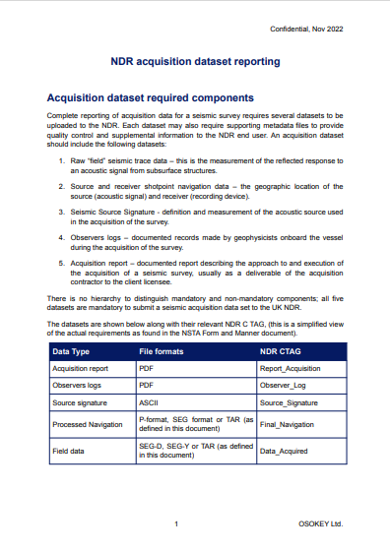
TFG007 - Legacy Seismic Reporting…
Propose to streamline reporting of acquisition data:
to enable elective reporting of such data by licensees,
to be relieved of the obligation to retain data, in perpetuity,
in an accessible and reusable state.
Scope: 2D & Site Surveys
4,300 surveys, 45 (~1%) of which are currently online
All revisions of SEG-D
Updates: Initial meeting (December) led to some useful feedback from licensees
Planned follow up (January) was postponed – yet to be rescheduled
Internal NSTA review of offline archive holdings has identified candidate acquisition data sets
Project work to develop archival code and process based on the proposed method
Development and internal testing to continue into April – then NSTA to re-engage TFG participants

Slide 13
TFG008 – DM Best Practices (Licensees)
We plan to run a series of workshops for licensees, looking at best practices for Data Management in the NDR
Relatively small groups to encourage open active participation – everyone to have their say
In November we asked you to vote for topics – the majority said they would like to cover managing the inventory
Sign up now:
The first workshop is planned for 11am on Tuesday 25 April, use this form to register your interest and we will send you an invite shortly
https://forms.office.com/e/g6hbe0XGT2

Slide 14
TFG009 – UAT: TIFF Log Image management
January 2022 - NSTA contacted a shortlist of licensees know to be impacted by this matter
Of those, several chose to participate with active engagement and feedback
Led to additional developments and deployment being rescheduled
Matter of files scanned to a depth of 1 bit per pixel is to be resolved
TFG010 – UAT: LAS validation by Well ID
February 2023 - NSTA invited data reporting licensees more broadly
Again, several companies elected to participate in User Acceptance Testing
Feedback centred on clarifications rather than technical issues
Change approved and deployed
Amendments to F&M drafted for publication

Slide 15
How To… Filter spatially and by data classification

Slide 16
Video 1:

Slide 17
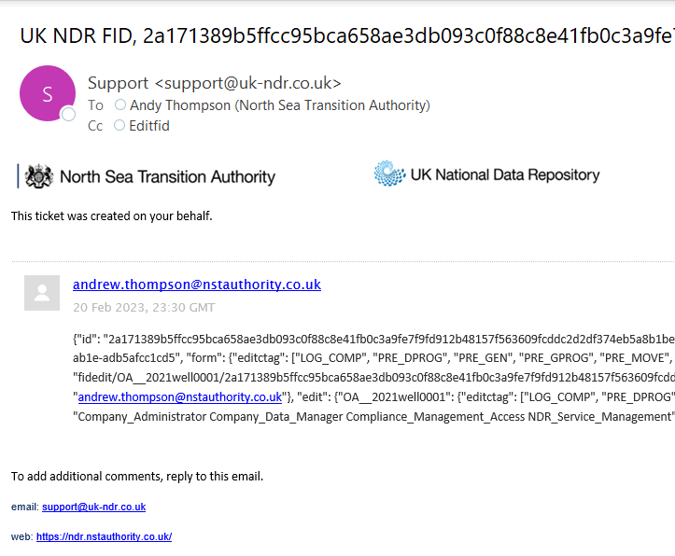
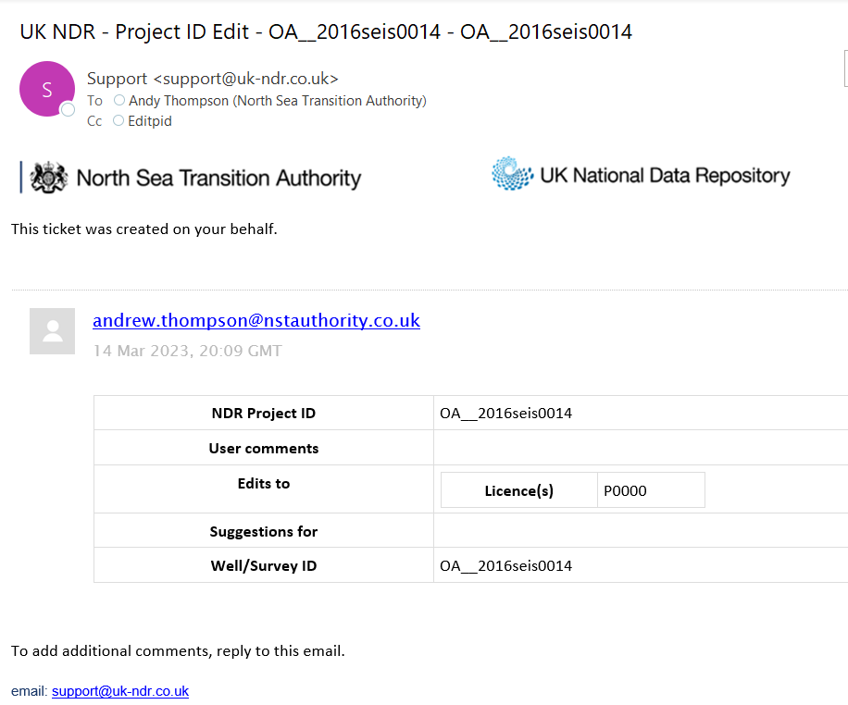
E-mail notifications from the NDR
UI/UX Review
Development
Implementation
Feedback themes
Accessibility issues
Unclear notifications
Subject - inconsistent
Content - acronyms
- ID codes
- layout
Scope of Work
Standardised Subject formats
[NDR Message ~ Activity ~ specifics]
A consistent look and feel
Facilitate in app filtering, auto rules etc.
Revisions to body text
Explanatory and reader accessible
Actioned for:
Reporting notice to ISC
Data Request workflows
Support ticket workflows
Suggested edits
Project & File metadata
User management workflows

Slide 18
Updates to Data Request and Suggest Edits Workflows
Data Request UI
Suggest Edits UI
Layout & Filtering
Changes to the NSTA-facing Data Request UI will make processing Data Requests easier to manage
Changes to the available columns and filtering will make it easier to process and track data requests
Layout & Workflow
Changes to the NSTA-facing Suggest Edits UI will provide the NSTA with direct access to approve edit requests
Approving or declining edit requests will be quicker
Positive impact on users

Slide 19
National Hydrocarbons Data Archive (NHDA)
Legacy System
Review
What next?
Managed by the BGS
Industry and Government
Licence Information archive
Relief of obligation to retain
Published for reuse
No submissions from 2016
Not necessarily in the NDR
Collaborative project
Identify gaps and overlaps
40+ surveys (3D, 2D, Site)
~200 GB well information
Other licence information?
Initial review of contents, March ’23
Demand led prioritisation
Otherwise NSTA to determine
Upload the delta
Confirm nothing omitted
Single source of information

Slide 20
Q&A
Task Finish Groups and Projects

Slide 21
How To… Add and use well metadata to filter a search

Slide 22
Video 2:

Slide 23
Forthcoming updates and developments

Slide 24
New C Tags for Geophysical Information
Why add more Classification Tags?
SEG-D archival procedure (TFG007) creates data artefacts – (not licence information)
Coverage Plot, Line Listing
Existing tags not sufficiently descriptive – “Navigation” applies to raw, processed and ‘decimated’ files
What will be added?
“Navigation” - Raw Navigation (P2/SEG formats), Final Navigation and “Ends and Bends” (P1)
Archival artefacts - Coverage Plot, Line Listing, Source Signature,
Remote Sensing - Data processed depth & Data processed time (by domain, aligned to seismic)
What implications are there?
Retirement of “Horizon”, “Data_processed”, “Navigation” – in due course. Some work to do.
No immediate involvement of data reporting licensees – may be some future consultation.
Ultimately the aim is to better describe data so it is more readily accessible.

Slide 25
New C Tags for Geophysical Information (2)
Project Types | Information Types | Classification Tag | File Format
mhaz, seis | Raw Navigation data | Raw_Navigation | P2 or SEG format
mhaz, seis | Processed Navigation data | Final_Navigation | P1 formats
mhaz, seis | Rationalised nav defining the start, end and turning points in 2D lines | Ends_and_Bends | P1 formats
mhaz, seis, rems | Source signature | Source_Signature | TXT (ASCII) or PDF
mhaz, seis | Plot of acquisition spatial coverage | Coverage_Plot | TXT (ASCII) or PDF
mhaz, seis, rems | List of lines included in the survey | Line_listing | TXT (ASCII)
rems | Processed data | Data_processed_time | TXT (ASCII)
rems | Processed data spatially referenced | Data_processed_time | GeoTIFF
mhaz, seis, rems, intp | Horizon, fault, grid and other interpretive data | Interpretation_time | TXT (ASCII)
mhaz, seis, rems, intp | Spatially referenced horizons and other interpretations | Interp_map_time | GeoTIFF
mhaz, seis, rems, intp | Horizon, fault, grid and other interpretive data | Interpretation_depth | TXT (ASCII)
mhaz, seis, rems, intp | Spatially referenced horizons and other interpretations | Interp_map_depth | GeoTIFF

Slide 26
Programmatic access to Wellbore Information
Legacy Systems
Development
What next?
“On Premise” UKOGD/NDR1
API services available
All files <1 GB
Almost exclusively well info
Averaged ~300K files/month
~570K files available
Few users – multiple use cases
Current NDR - Cloud Based
Different context to work in
All wellbore information
No file size limit
~700K files available
From concept to development
Internal acceptance testing
“Commercialisation”
Complete internal testing
Agree cost model
NSTA provision of base service
“User Pays” for high demand
External testing – plan tbd

Slide 27
Q&A
Developments

Slide 28
Q&A Developments
Geophysical Classification Tags
API / Programmatic access to data
Information Types | C Tag
Raw Navigation data | Raw_Navigation
Processed Navigation data | Final_Navigation
Rationalised 2D Navigation | Ends_and_Bends
Source signature | Source_Signature
Plot of acquisition spatial coverage | Coverage_Plot
List of lines included in the survey | Line_listing
Why? SEG-D archival artefacts; differentiation
What? Navigation
Acquisition seismic information
Remote sensing information and interpretation
How? Introduction of new, suspend assignment of old
reclassification of legacy data – timing tbd
What? All disclosed wellbore information
>700K files available
including recently disclosed
NSTA provisioned service
User Pays opt in for high demand use cases
External testing & deployment schedule to be determined

Slide 29
How To… Manage displays of the map and tables

Slide 30
Video 3:

Slide 31
Next steps

Slide 32
Next steps – 3 month outlook
Development plan – continuous improvement
Classification Tags for Geophysical information types
Programmatic access to data
NSTA strategic projects
OCR of legacy data collection (following 2021 PoC)
Enabling data transfer to user’s cloud tenant
Carbon Storage Licences – Information and Samples
Consultation response to be published shortly
Setting out responders’ views
Implications for development of the NDR to accommodate CS Licence Information

Slide 33
Dates For Your Diary
Month | Date | Event | Participants
April | Tue 25 | TFG008 – DM Best Practices | Licensee Users (DMs)
June | Tue 27 | NDR User Group Meeting 9 (hybrid) | All NDR Users
September | Tue 5* | NDR User Group Meeting 10 (online) | All NDR Users
November | Tue 14* | NDR User Group Meeting 11 (hybrid) | All NDR Users
 | TBC | TFG007 – Review: Legacy Seismic Reporting | Data Reporting Licensees
*Provisional date

Slide 34
Q&A: Next Steps

Slide 35
Contact Information
NSTA NDR Team
NDR Team - email our mailbox ndr@nstauthority.co.uk
General enquires in relation to the National Data Repository
Referrals to NSTA colleagues or Support Centre, where appropriate
Register for the NDR contacts register – updates and User Group
NDR Support Centre
Technical support for matters in relation to using the National Data Repository
Advice on how to use the UI, uploading data, downloads, ordering on media, metadata services
Osokey and Moveout technical expertise
support@uk-ndr.co.uk
https://support.uk-ndr.co.uk/
in app Support Centre launch – raise tickets, support articles and video explainers
Support Centre chat option

Slide 36
Thank You

