Slide 1
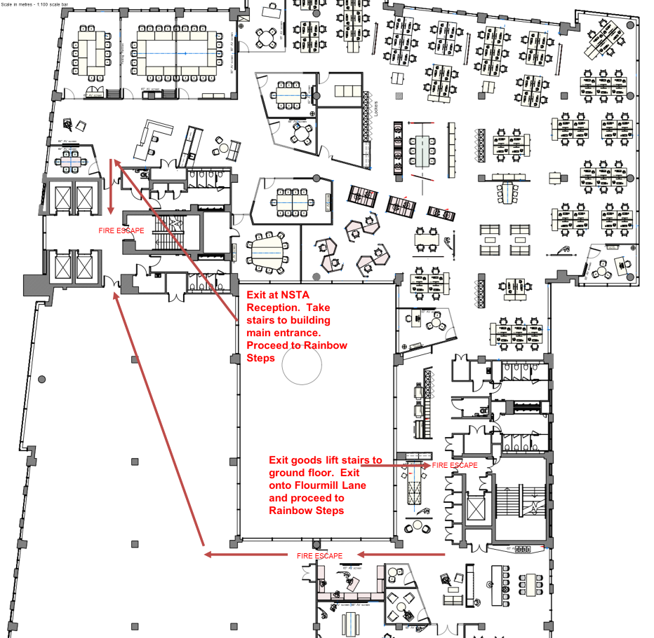
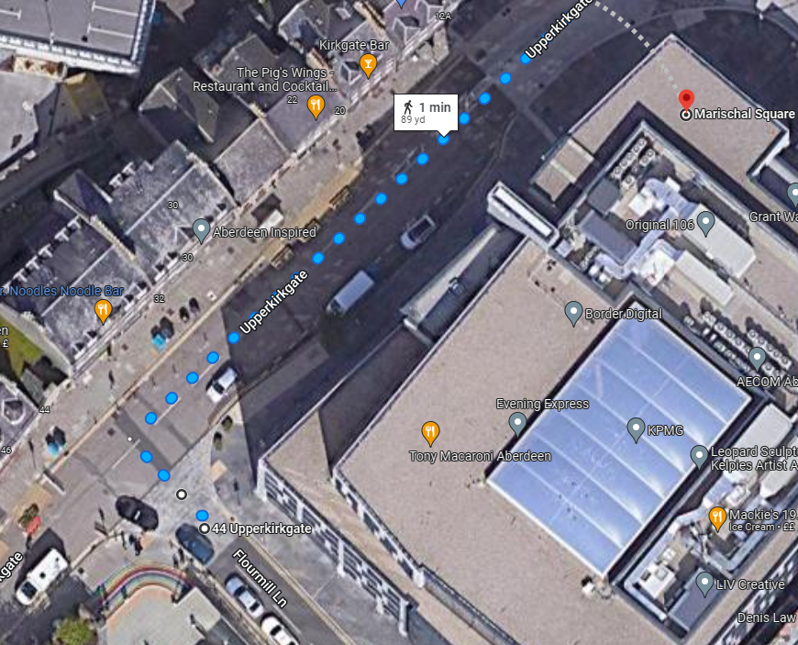
Safety Moment Please take note of the fire exits. The assembly point is the rainbow steps on Flourmill Lane. There is a planned fire alarm test at 12pm.
You are here

Slide 2
UK National Data Repository
User Group Meeting No. 7
29th November 2022

Slide 3
WELCOME TO OUR FIRST HYBRID NDR USER GROUP

Slide 4
Meeting etiquette & structure
For those joining us via Microsoft Teams:
Please turn your cameras off and remain muted.
Please use the meeting chat to post your questions throughout the meeting.
Questions raised in the meeting chat will be addressed at the end of each section of today’s presentation, time permitting.
For those joining us in the room:
Please feel free to ask questions at the end of each section of today’s meeting. There will also be ample time for discussion at the end and during lunch.
The meeting will not be recorded - slides to be shared on the NSTA NDR User Group web page

Slide 5
Agenda
Introduction and general topics (11:00)
General updates: Version releases, Updates to documentation
Well data availability
Seismic data availability
Task Finish Groups & Projects (11:25)
TFG006 – Cloud to Cloud seismic data reporting
TFG007 – Proposed - Legacy Seismic Data Reporting
TFG008 – Proposed - Data Management Best Practices for Licensees
Review and Discussion - Inventory & Data Requests (11:50)
UI/UX Review and Developments Outline
Discussion Q&A
Next steps – 3 month outlook (12:15)
Development plan summary
Dates for your diary & NDR Contact information

Slide 6
Version, documentation and other updates
v20220930_17 Notice to NDR stakeholders 3.10.22
Data Discovery Map - Spatial filtering by offshore block – populate Project table in one click
Project & File Tables - Processing 30 projects simultaneously – increased from 10
- Accessibility – active/inactive buttons, clarification of mouseovers, abbreviations
- Searchability – data range filters, handling of Well SoR attributes
- Area attribute – differentiating major areas of the UKCS (WoS, SNS, EIS etc.)
Coordinate Systems - Formalised support for the TM0 North CRS
https://support.uk-ndr.co.uk/hc/en-gb/articles/7913974530578-Release-Notes-30th-September-2022
v20221111_16 Notice to NDR stakeholders 11.11.22
Project Table - Area attribute populated for seismic and site survey projects, and “CSC” area added
Project & File Tables - Depth range filter functionality added to well attributes
Classification Tags - Extended handling of CS8/C Tag mapping to the Data Request workflow UI
https://support.uk-ndr.co.uk/hc/en-gb/articles/8598764628370-Release-notes-11th-November-2022

Slide 7
Version, documentation and other updates.
Documentation:
Form & Manner for NDR: Recent update announced in November 2022
Largely involved moving from the old OGA branding to the up to date NSTA branding and layout
Material changes to clarify required formatting of SEG-D to promote sensible file management
https://www.nstauthority.co.uk/media/8512/information-reporting-form-and-manner-for-ndr-november-2022-v2.pdf
NSTA intends to update its position with:
Acceptance of TIFF format for “LOG IMAGE” file types for wells completed prior to 2018
Validation of LAS format “DWL FILE” file types using PON12 Well ID, rather than surface location
Revisions to the document will coincide with the deployment of changes to requirements.
NDR User Agreement: Revised version in NSTA branding to be posted – no substantive changes to terms

Slide 8
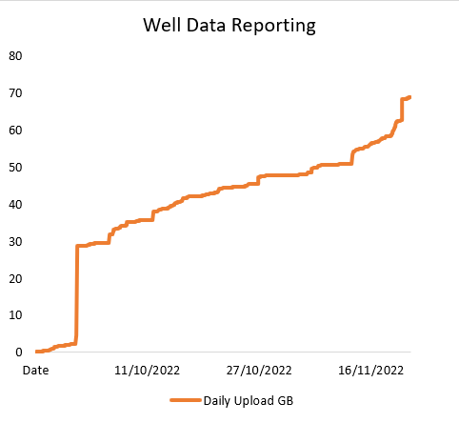
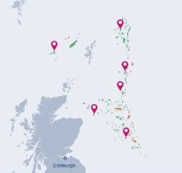
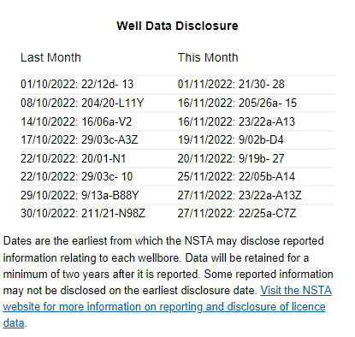
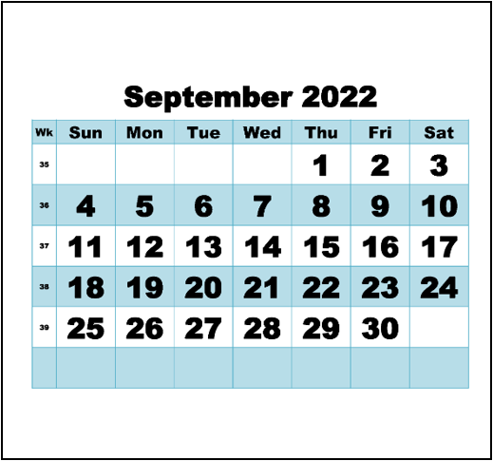
Well data availability update
October/November
Legacy Data
Modern Data
Improving Data
70 GB data reported
Wells completed every year from 1966 to 2022
43 GB to EA2016 wells
Mostly to 46 recently completed wells; 2021/22
All data remains protected
27 GB data released
Relating to 492 individual wells
PA1998 completed <2018
Eligible for immediate release
Response to Data Requests
4 GB data released
16 EA2016 wells released over October and November
Announced monthly but are actioned when eligible
>1000 files recently acquired data (2020 completions)
10 wellbores, 850 files
Completed in March 2020
14% in invalid file formats
Wireline Logs (LAS) as .pdf
Dev Survey (ASCII) as .csv
Digital mudlog (ASCII) as .txt
0 instances after July 2021

Slide 9
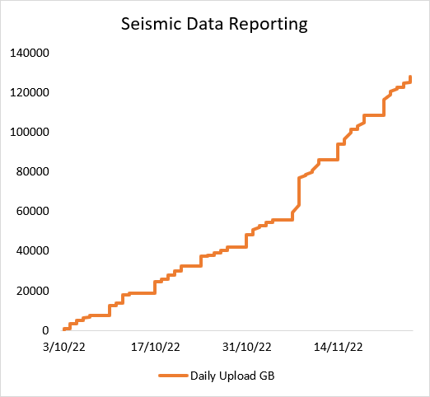
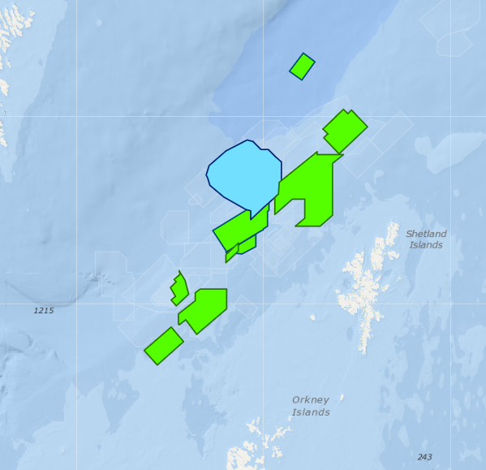
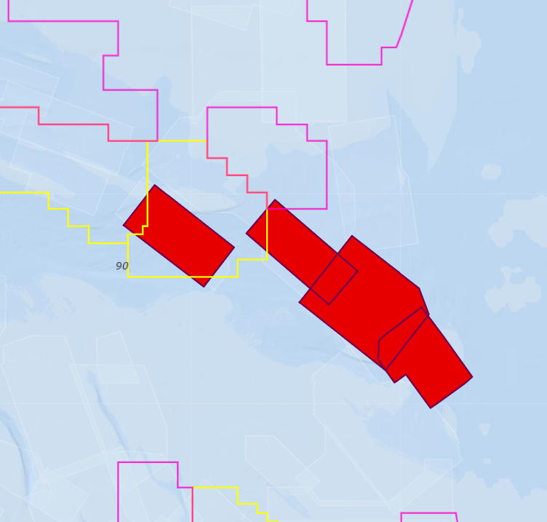
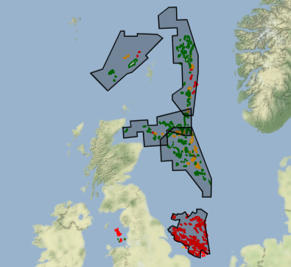
Seismic data availability update
October/November
Offline to Cloud
Remaining Offline
Processed Data
125 TB uploaded/reported
>70% data loaded during October / November is eligible for immediate disclosure
5 MB doc for a '71 survey
35 TB field data for 2019 OBN, routinely reported, and remains ‘protected’
Field & Processed Data
Osokey migrating NSTA’s SEG-D from regional 2D surveys (2015 & 2016)
NSTA/Moveout collaboration WoS surveys nav-merged
SEG-Y in response to 33rd Round data requests
Field & Processed Data
9 3D SEG-D data sets
4 x SNS & 5 x CNS
Various deficiencies mean currently we can’t nav-merge
Some overlap with current and prospective CS licences
SEG-Y and other data offline
Reporting request led
Post Stack, Velocities etc.
Relating to eighteen surveys
Reported by 15 licensees
Mostly of 1990’s vintage
Last of four regional merged post stack volumes from Lyme Bay Consulting

Slide 10
Q&A
General topics

Slide 11
Task Finish Groups and Projects

Slide 12
TFG006 – Cloud to Cloud Seismic Reporting
Initiated over the summer - NDR Team approached a short list of licensees
Significant holdings of legacy and current seismic data
Thought to be hosting seismic data in cloud based systems
The conditions exist for licensees to report data directly from their cloud systems to the NDR
We expect there are efficiencies to be had from direct data transfer – time and/or costs
We don’t know for certain – we don’t have visibility of licensee systems, commercial arrangements with suppliers etc.
If there are ways to leverage technology to enable efficient, effective and less costly reporting, then we’d like to see them being used
Licensees, DM and cloud hosting service providers – contact ndr@nstauthority.co.uk if you would like to participate in this group.

Slide 13
TFG007 - Legacy Seismic Reporting
We’re considering how to enable reporting of legacy seismic data while maintaining standards
Is it better to have legacy data in the national archive, or licensees archives?
Plenty of good reasons to have data reported to the NDR
Create an enduring archive of a nationally significant asset
Make data available to a growing and diverse range of use cases
Enable licensees to gain relief from the obligation to retain data in perpetuity
Recent NSTA exercise to understand the landscape:
Particular focus on acquisition data – SEG-D
Mixed situation and responses to NSTA colleagues still to be finalised
NSTA is considering options:
Legacy data in legacy formats – according to the retention requirements of the time
Ensuring quality and completeness, for future reuse

Slide 14
TFG007 - Legacy Seismic Reporting.
Prior to 2018: PON9 required (and still requires) licensees to retain survey data in perpetuity, unless requested to report data by the NSTA
Historically there was no permanent value case for routine reporting of field/acquisition data
In practice: Licensees retain data, often on magnetic tape, periodically remastered to replacement media, to ensure the data is recoverable when required
Several instances of licensees holding legacy data in hosted storage – in house or externally
NDR today: >1,500* processed seismic data sets online, reporting is generally not driving support tickets
Processed seismic online (Released) | Total (approx.) | Data Online |  | Pre 1990 | Data Online |  | Post 1990 | Data Online
2D & Site Surveys | 4300 | 1073 | 25% |  | 3500 | 717 | 20% |  | 800 | 356 | 45%
3D Surveys | 700 | 375 | 54% |  | 100 | 66 | 66% |  | 600 | 309 | 52%
4D & OBS Surveys | 120 | 42 | 35% |  | 0 |  |  |  | 120 | 42 | 35%
* Figure includes data reported to as yet unreleased surveys

Slide 15
TFG007 - Legacy Seismic Reporting..
Reporting standards: The NDR has been configured to require data to align to specific requirements in format and condition, and to be reported via specified methods (“Form and Manner”)
Field seismic: SEG-D rev 2.1 or later, or SEG-Y nav-seis merge, to be uploaded to the NDR
Legacy data was acquired and is retained in earlier SEG formats
Effort and cost deters “elective reporting” by licensees
Acquisition Data: Acquisition report Observer logs Source & Receiver SP Navigation
Source signature SEG-D
Field seismic online (Released) | Total (approx.) | Data Online |  | Pre 1990 | Data Online |  | Post 1990 | Data Online
2D & Site Surveys | 4300 | 45 | 1% |  | 3500 | 28 | <1% |  | 800 | 17 | 2%
3D Surveys | 700 | 71 | 10% |  | 100 | 3 | 3% |  | 600 | 68 | 11%
4D & OBS Surveys | 120 | 2 | <2% |  | 0 |  |  |  | 120 | 2 | <2%

Slide 16
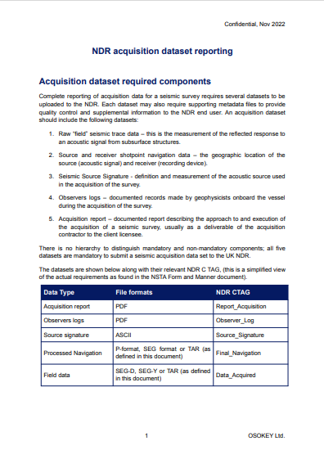
TFG007 - Legacy Seismic Reporting…
Propose to streamline reporting of acquisition data:
to enable elective reporting of such data by licensees,
to be relieved of the obligation to retain data, in perpetuity,
in an accessible and reusable state.
Scope: 2D & Site Surveys
4,300 surveys, 45 (~1%) of which are currently online
All revisions of SEG-D
Objectives Devise a method for creating a file archive format
Incorporate ancillary acquisition information types
Develop and test archive methods and adapt NDR upload routines
Formalise as a compliant NDR reporting procedure, including updates to F&M documentation etc.

Slide 17
TFG008 – DM Best Practices (Licensees)
We’re proposing to run a series of workshops for licensees, looking at best practices for Data Management in the NDR
Small-ish groups to encourage open active participation – everyone to have their say
Suggested topics: Loading seismic data Managing the Inventory
Editing Classification Tags Registering Well and Seismic Projects
Confirmation of loading success

Slide 18
Q&A
Task Finish Groups and Projects

Slide 19
Review – Inventory and Data Requests

Slide 20
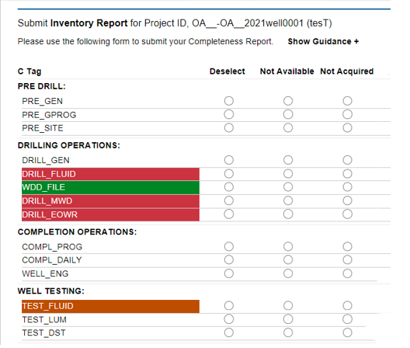
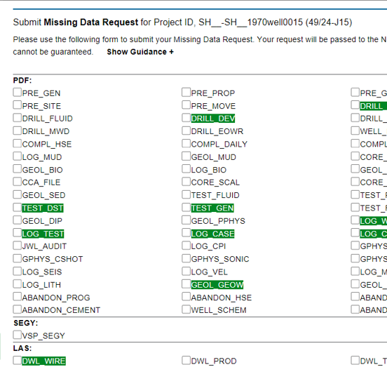
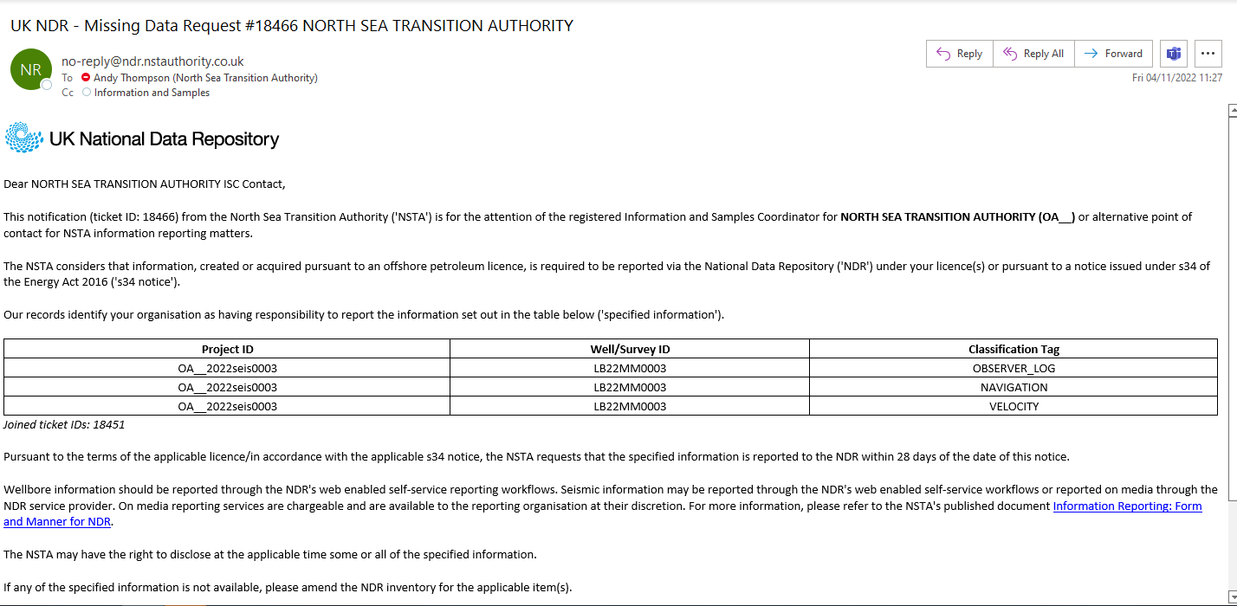
Inventory & Data Requests
UI/UX Review
Inventory UI
Data Request UI
Notifications
Feedback themes
Accessibility issues
Unclear notifications
Tracking – status updates
Lengthy turnaround times
NSTA Functionality
Layout & Workflow
Sticky Header on columns
Retain titles when scrolling
Remove Red/Orange/Green
“Available” column & icons
Use available space
Edit Classification workflow
Layout & Workflow
Adopt Inventory UI format
Accessibility updates
Wellbore operations stages
Seismic survey stages (new)
Acquisition
Pre & Post Stack
Workflow generated
Adopt Reporting Notice style
Request acknowledgement
Company DM message
Company DM opt out
Close out to messages
Compliance Team workflows

Slide 21
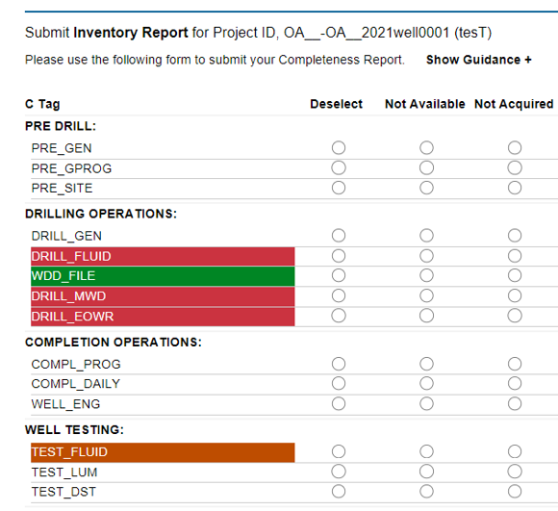
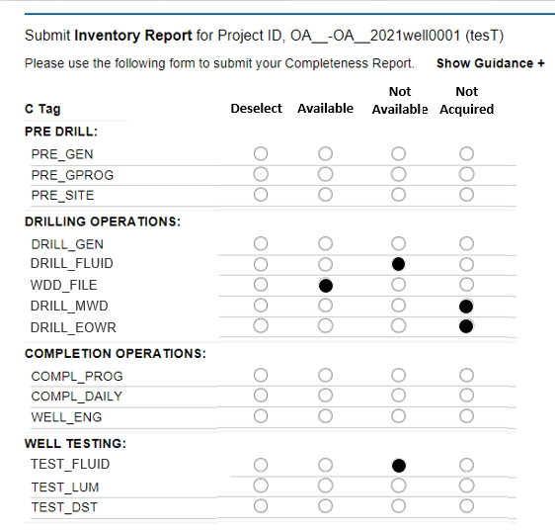
Inventory – proposed changes

Slide 22
Inventory & Data Requests.
UI/UX Review
Inventory UI
Data Request UI
Notifications
Feedback themes
Accessibility issues
Unclear notifications
Tracking – status updates
Lengthy turnaround times
NSTA Functionality
Layout & Workflow
Sticky Header on columns
Retain titles when scrolling
Remove Red/Orange/Green
“Available” column & icons
Use available space
Edit Classification workflow
Layout & Workflow
Adopt Inventory UI format
Accessibility updates
Wellbore operations stages
Seismic survey stages (new)
Acquisition
Pre & Post Stack
Workflow generated
Adopt Reporting Notice style
Request acknowledgement
Company DM message
Company DM opt out
Close out to messages
Compliance Team workflows

Slide 23
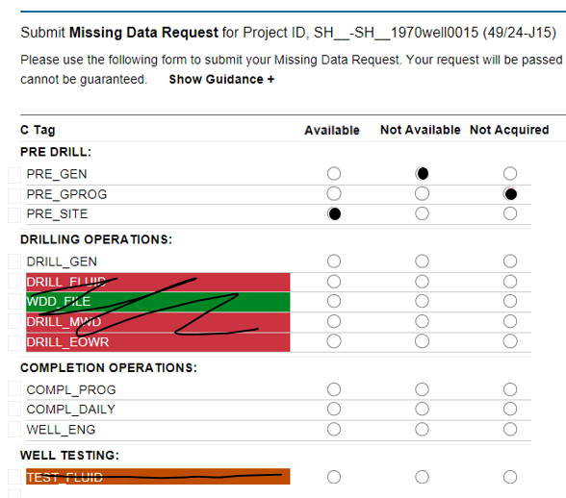
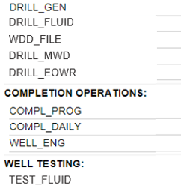
Data Requests – proposed changes

Slide 24
Inventory & Data Requests..
UI/UX Review
Inventory UI
Data Request UI
Notifications
Feedback themes
Accessibility issues
Unclear notifications
Tracking – status updates
Lengthy turnaround times
NSTA Functionality
Layout & Workflow
Sticky Header on columns
Retain titles when scrolling
Remove Red/Orange/Green
“Available” column & icons
Use available space
Edit Classification workflow
Layout & Workflow
Adopt Inventory UI format
Accessibility updates
Wellbore operations stages
Seismic survey stages (new)
Acquisition
Pre & Post Stack
Workflow generated
Adopt Reporting Notice style
Request acknowledgement
Company DM message
Company DM opt out
Close out to messages
Compliance Team workflows

Slide 25
Data Requests – ISC reporting notice

Slide 26
Discussion – Questions on planned updates
UI/UX Review
Inventory UI
Data Request UI
Notifications
Feedback themes
Accessibility issues
Unclear notifications
Tracking – status updates
Lengthy turnaround times
NSTA Functionality
Layout & Workflow
Sticky Header on columns
Retain titles when scrolling
Remove Red/Orange/Green
“Available” column & icons
Use available space
Edit Classification workflow
Layout & Workflow
Adopt Inventory UI format
Accessibility updates
Wellbore operations stages
Seismic survey stages (new)
Acquisition
Pre & Post Stack
Workflow generated
Adopt Reporting Notice style
Request acknowledgement
Company DM message
Company DM opt out
Close out to messages
Compliance Team workflows

Slide 27
Next steps

Slide 28
Next steps – 3 month outlook
Development plan – continuous improvement
Accessibility and general layout of Inventory and Data Request UIs
Data Request workflow and notification changes
Accepting TIFF for legacy Log Image files and revising LAS header validation
NSTA strategic projects
OCR of legacy data collection (following 2021 PoC)
Programmatic access to data
Enabling data transfer to user’s cloud tenant
Licensing Rounds
Offshore Petroleum Licensing Round – closing in January
How did the NDR contribute to your company’s involvement?
Questionnaire (as we did for Carbon Storage licensing) – https://forms.office.com/e/8Pr22Tsh2W

Slide 29
Q&A
Next steps

Slide 30
Dates For Your Diary
Month | Date | Event | Participants
December | Thu 8 | TFG007 – Kick Off: Legacy Seismic Reporting | Data Reporting Licensees
January | Tue 10 | TFG007 – Review: Legacy Seismic Reporting | Data Reporting Licensees
March | Tue 28* | NDR User Group Meeting 8 | All NDR Users
June | Tue 27* | NDR User Group Meeting 9 | All NDR Users
TBC | TBC | TFG008 – Data Management Best Practice | Data Reporting Licensees
*Provisional date

Slide 31
Contact Information
NSTA NDR Team
Miriam, Dave and Andy email our mailbox ndr@nstauthority.co.uk
General enquires in relation to the National Data Repository
Referrals to NSTA colleagues or Support Centre, where appropriate
Register for the NDR contacts register – updates and User Group
NDR Support Centre
Technical support for matters in relation to using the National Data Repository
Advice on how to use the UI, uploading data, downloads, ordering on media, metadata services
Osokey and Moveout technical expertise
support@uk-ndr.co.uk
https://support.uk-ndr.co.uk/
in app Support Centre launch – raise tickets, support articles and video explainers
Support Centre chat option

Slide 32
Thank You

