Slide 1
NDR User Group
Meeting Two
9 June 2021

Slide 2
Meeting Etiquette
Please keep your microphone muted and video switched off unless you are speaking.
If you have any comments or questions please record these in the meeting chat. We will endeavour to answer during the meeting or follow up with you.
Questions will be moderated during the call.
Slides will be made available on the OGA website following this meeting.

Slide 3
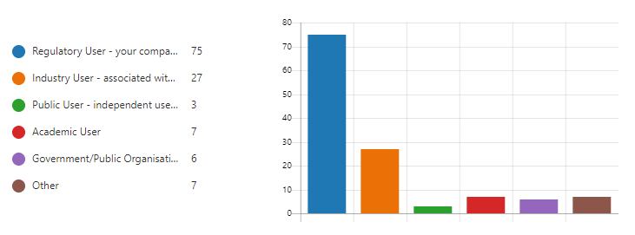
Who is in the call?

Slide 4
Welcome and Agenda: NDR User Group 2
Introduction - John Seabourn (Chief Digital Officer) 5m
Compliance and data quality – David Lecore (Head of Data Services & Compliance) 10m
Transition Project update – Andy Thompson (NDR Manager) 5m
A look at forthcoming functionality – Joseph Nicholson (Osokey) 20m
Short break
NDR User FAQs Overview – Andy Thompson (NDR Manager) 40m
Open Q&A – Andy Thompson & Joseph Nicholson (Osokey) 20m

Slide 5
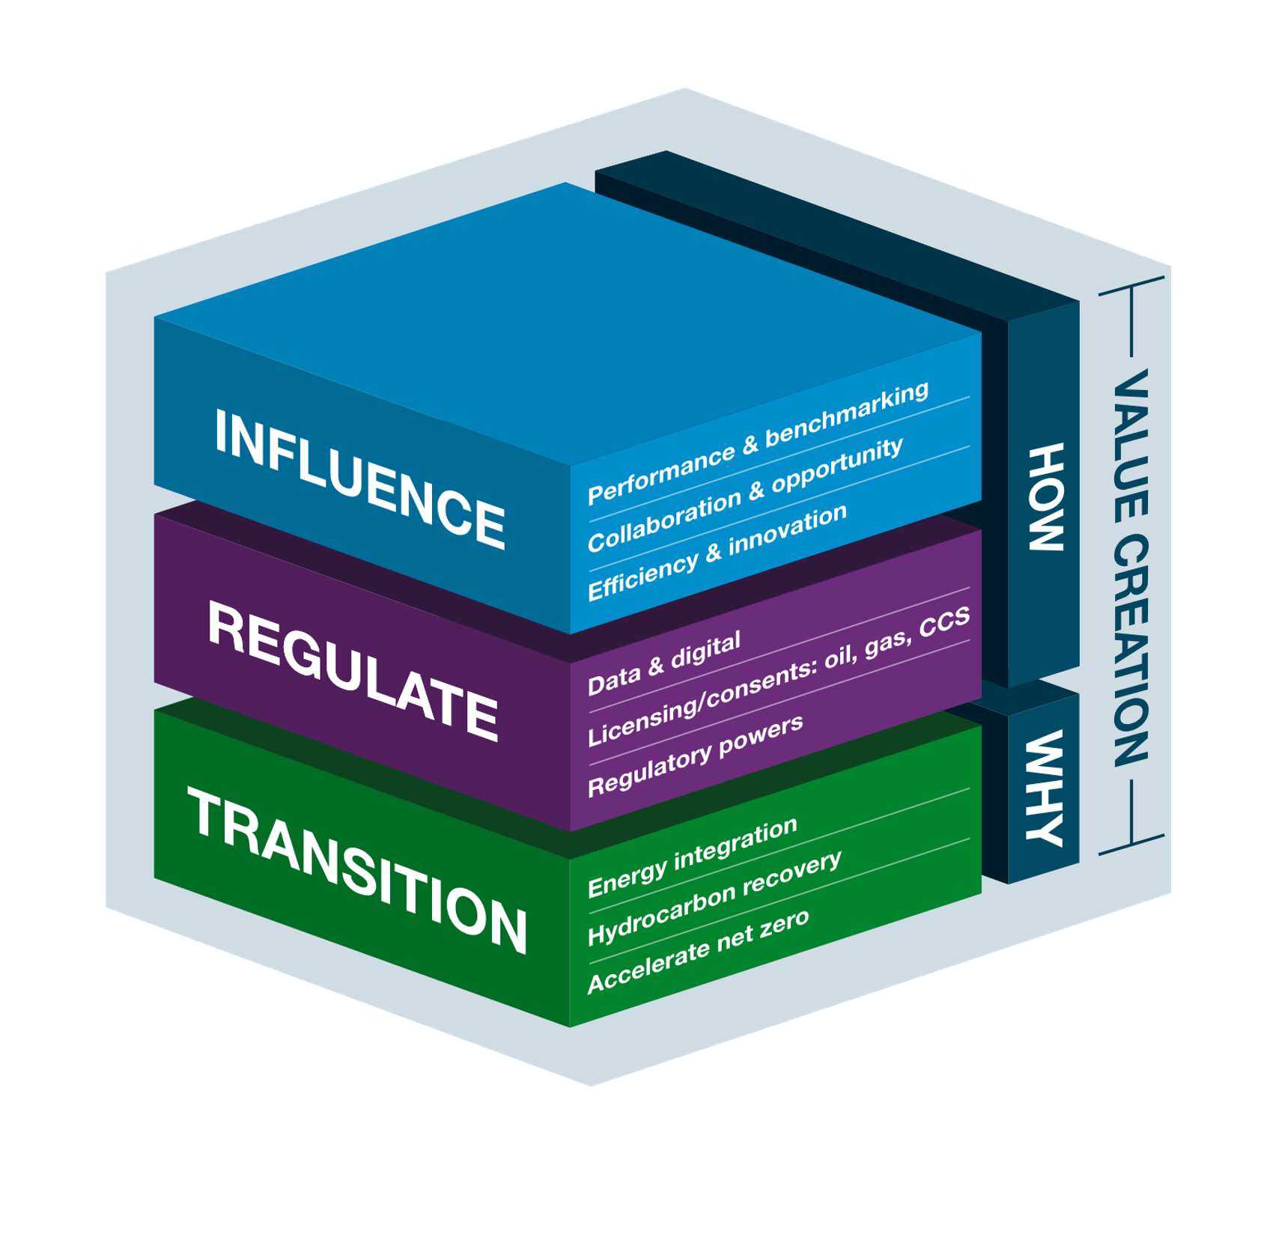
What is the OGA’s role?
“The Oil and Gas Authority’s (OGA) role is to regulate and influence the UK oil and gas industry. The OGA aims to be a value creator; maximising economic recovery from the UK’s hydrocarbon resources and helping meet the UK’s energy demands, whilst supporting the industry’s energy transition and move to net zero carbon by 2050. It works in conjunction with other regulatory authorities and has a range of powers to deliver this remit”
OGA Strategy, 2020
“the ready access to timely data is a prerequisite for a competitive market and this is even more important in an industry which relies on good data to create value”
Sir Ian Wood (The Wood Maximising Recovery Review), 2014

Slide 6
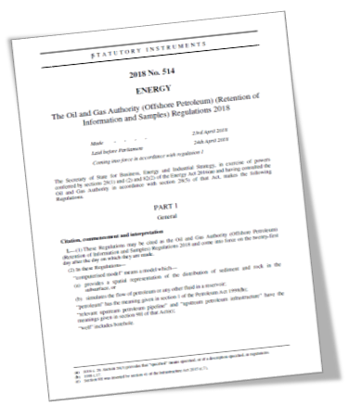
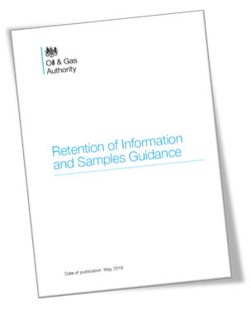
How OGA approach Data & Digital
Fundamental change in delivering value
Form and Manner
Challenging the Status Quo
New systems = New processes
The new system is designed to be a major change from the existing system
The purpose of the NDR is to enable the reporting of information and samples to the OGA and manage their subsequent disclosure
Modern data ingress and egress make this a much easier process
Data quality built in
The OGA requires that data reported to the NDR conforms to the required “from and manner” set out by the OGA
The OGA now has the technology to ensure that quality data is reported to the NDR
This enables us to take a more robust posture on compliance
The new system….
Has been designed for the cloud computing era to be scalable and sustainable
Will be progressively developed to meet user needs – please give the OGA feedback
The purpose and users of the service is much expanded

Slide 7
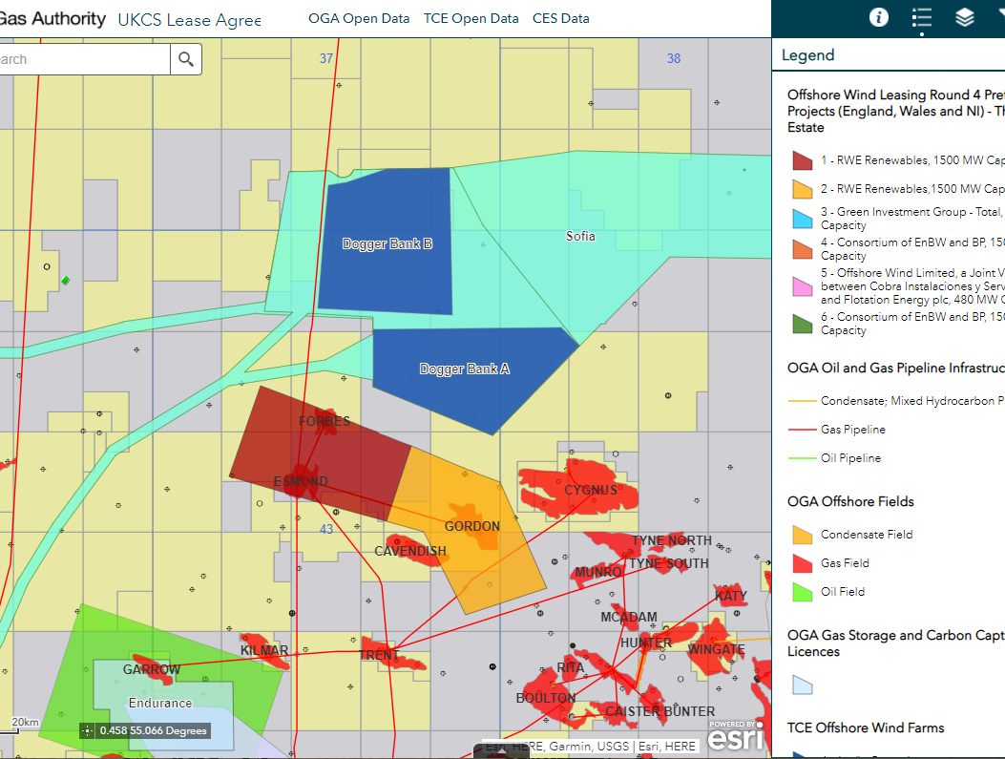
Why?
Energy Transition
Hydrocarbon Recovery
Accelerate Net Zero
Data Quality, accuracy and completeness for Net Zero
Using powers to ensure that unreported data in the SNS from 900 wells is used to define opportunities for strategically important CCUS sites and help drive the Net Zero agenda
The OGA is now publishing GIS applications that integrate data for the drive to Net Zero
Data Supports Energy Transition
The OGA has been key in supporting the successful plans to develop the Greater Buchan Area
Using a new approach to licensing and maximising the use of open data, the development is now gathering pace – and is planned to be electrified delivering more energy more cleanly
Maximising Economic Recovery
This requires timely quality data from multiple sources to enable effective decision making
The powers, tools, skills and processes that the OGA use are a key enabler of this important work

Slide 8
Agenda: NDR User Group 2
Introduction - John Seabourn (Chief Digital Officer) 5m
Compliance and data quality – David Lecore (Head of Data Services & Compliance) 10m
Transition Project Update – Andy Thompson (NDR Manager) 5m
A look at forthcoming functionality – Joseph Nicholson (Osokey) 20m
Short Break
NDR User FAQs Overview – Andy Thompson (NDR Manager) 40m
Open Q&A – Andy Thompson & Joseph Nicholson (Osokey) 20m

Slide 9
Compliance and Data Quality
 | Summary data | Data
Wellbore
Seismic |  | Historically seismic data was not routinely reported
Infrastructure |  | No ‘data’ currently reported
1.
Wellbore
Headers
2.
Wellbore
Information
Seismic
Survey
Headers
3.
Infrastructure
Summary
Information
4.

Slide 10
Presented at
PPDM
Data Byte’
Feb 2021
Status quo
Prior to NDR 1.0 the OGA conducted work to allow WONS to be the System of Record for wellbores
Rationalisation of 9 key attributes across WONS and NDR
Many years of divergence had led to two very different systems
This work did not entirely solve the problem
Some of those 9 values in WONS are not passed to NDR due to legacy scripts (BHLs)
Other attributes were not worked on i.e. Target Field – but their importance has increased (due to ownership)
Recent compliance work
OGA are measuring compliance on some WONS header information
This is just 7 key attributes
OGA efforts to make improvements have been compounded by lack of industry focus / poor understanding
>500 wellbores in NDR had incorrect ownership allocation in Q1 2019 remedial is only just finishing now

Slide 11
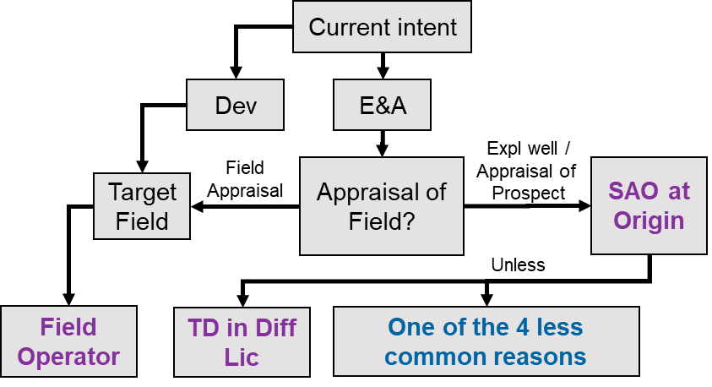
Wellbore headers are owned by well owners
Impact
Headers are important and are used by many (not just the owner)
The OGA well headers should be ‘the’ go to headers, minimising effort by others to maintain their own
Correct ownership allocation will help in the loading of missing legacy data
Poor quality impacts many people and reduces the quality of subsequent work (candidate selection for CCUS)
Future
WONS will more than ever be the SoR of wellbore data and will provide the NDR with most well attribute values
Responsibility for reporting data decision tree
Less common reasons for responsibility:
Licensee – acting for Licence Group
Sole risk well operator (1 or more licensees acting outside of the licence group)
New Licensee entering the licence
Hive out
Decision tree requires:
TD location and licence information
Target field information

Slide 12
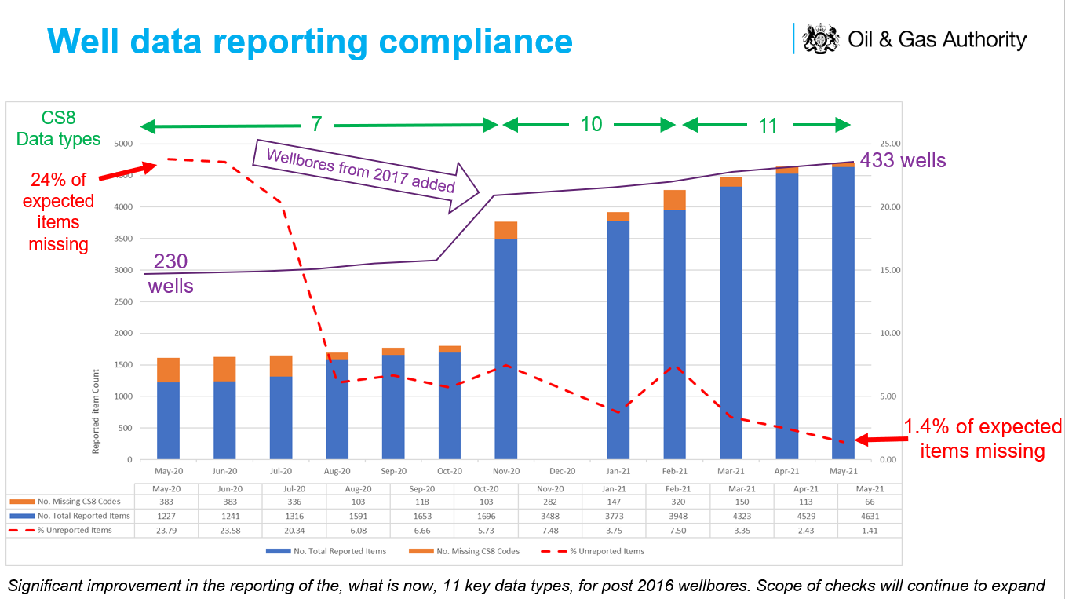
Wellbore data is owned by well owners
Status quo
Completeness of the current data set varies considerably – based on vintage and data owner interpretation of reporting requirements / appetite to fulfil
High item count is no measure of compliance
Past PON 9 ‘basic set’ requirements were a low bar that data owners tried to reach – as opposed to the absolute minimum required
Recent compliance work
Recent OGA compliance work has be very successful
11 items types being monitored
Missing items in May 2020 = 24% - now 1.4%
Good improvement in compliance – and communication of this to ISCs

Slide 13
Wellbore information 2
Impact
A complete data set will have a positive impact on MER and will be a requirement for Energy Transition
Reporting data (in the correct from and manner) relieves the obligation to retain – so can reduce industry costs
Future
The ability of the OGA to measure compliance (more items types) will increase due to Data Warehouse
The QC of data at ingress will improve due to NDR functionality

Slide 14
Seismic summary data is owned by survey owners
Status quo
Seismic headers in the current NDR are not ‘used’ as much a wellbore headers
5092 headers – only 1507 have any data loaded
80% of the headers are pre 1995
Any dataset that is not used, will be lower quality than otherwise – the seismic headers are no exception
Recent compliance work
The OGA has not, to date, focused much attention on the quality of seismic headers
Impact
Seismic data loading is about to increase significantly - the low quality of the headers will impact this
Most concerning will be ownership errors – which prevent the true owner loading data
Future
OGA will work with survey owners to improve the quality of the survey headers
Improvement in the header creation process will be made

Slide 15
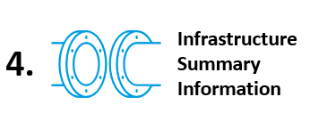
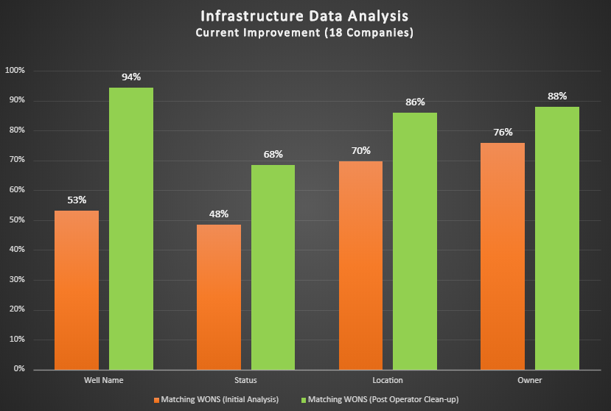
Infrastructure summary data is owned by infrastructure owners
Status quo
Data ‘refreshed’ in 2 cycles / year
‘Changes’ within past period should be reported (additions / modifications / removals)
Data was inherited by CDA and subsequently OGA
Current quality is very low
Recent compliance work
Other than ‘use of Powers’ OGA has twice highlighted issues with specific data types to ‘highlight’ the magnitude of the overall poor quality

Slide 16
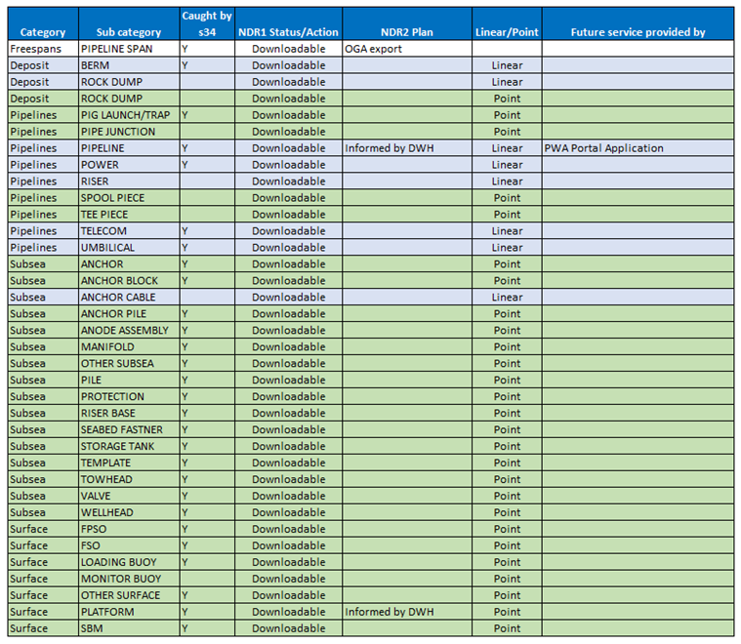
Infrastructure Summary Data
Impact
Infrastructure data (along with well and survey data) will play an important role in Energy Transition
Infrastructure ‘data’ is not currently reported – but the OGA does have the power to request this information
When the OGA does request ‘information’, a high quality set of summary information will help
Future
The ‘form and manner’ of reporting Infrastructure Summary Information’ is about to change
In October information will be reported using Shape Files and Feature Classes (similar in format to the files available on the OGA Data Centre
The ‘classification’ of items will be improved

Slide 17
Agenda: NDR User Group 2
Introduction - John Seabourn (OGA Chief Digital Officer) 5m
Compliance and data quality – David Lecore (Head of Data Services & Compliance) 10m
Transition Project Update – Andy Thompson (NDR Manager) 5m
A look at forthcoming functionality – Joseph Nicholson (Osokey) 20m
Short Break
NDR User FAQs Overview – Andy Thompson (NDR Manager) 40m
Open Q&A – Andy Thompson & Joseph Nicholson (Osokey) 20m

Slide 18
Transition Project
Suspension of survey loading
requiring tape transcription
or payment by invoice
Suspension of orders
payment by invoice
Suspension of loading
Credit card payment
Suspension of orders
Paid by credit card
OGA NDR Cloud Subscriptions commissioned
“Soft Freeze”
of changes to transferred data
“Hard Freeze”
of addition and changes to all data
*“Regulatory” functionality available to
authorised users
Future NDR launch*
User
Group
Agile enhancement dev & deployment
Dec
Jan
Feb
Mar
Apr
May
Jun
Jul
Aug
Sep
June 2026
User
Group
NDR 2
Contract Signed
CDA Data Transfer Plan
Bulk Transfer
of NDR data & metadata starts
~26 TB
Delta Transfer of data & metadata
Current NDR Service ceases
Public Launch
Permanent removal of data from NDR 1
Transfer of Data
on physical media
Ingress of ~100 TB OGA Gov. Funded Seismic

Slide 19
Agenda: NDR User Group 2
Introduction - John Seabourn (OGA Chief Digital Officer) 5m
Compliance and data quality – David Lecore (Head of Data Services & Compliance) 10m
Transition Project Update – Andy Thompson (NDR Manager) 5m
A look at forthcoming functionality – Joseph Nicholson (Osokey) 20m
Short Break
NDR User FAQs Overview – Andy Thompson (NDR Manager) 40m
Open Q&A – Andy Thompson & Joseph Nicholson (Osokey) 20m

Slide 20
A Look Ahead

Slide 21
Agenda: NDR User Group 2
Introduction - John Seabourn (OGA Chief Digital Officer) 5m
Compliance and data quality – David Lecore (Head of Data Services & Compliance) 10m
Transition Project Update – Andy Thompson (NDR Manager) 5m
A look at forthcoming functionality – Joseph Nicholson (Osokey) 20m
Short Break
NDR User FAQs Overview – Andy Thompson (NDR Manager) 40m
Open Q&A – Andy Thompson & Joseph Nicholson (Osokey) 20m

Slide 22
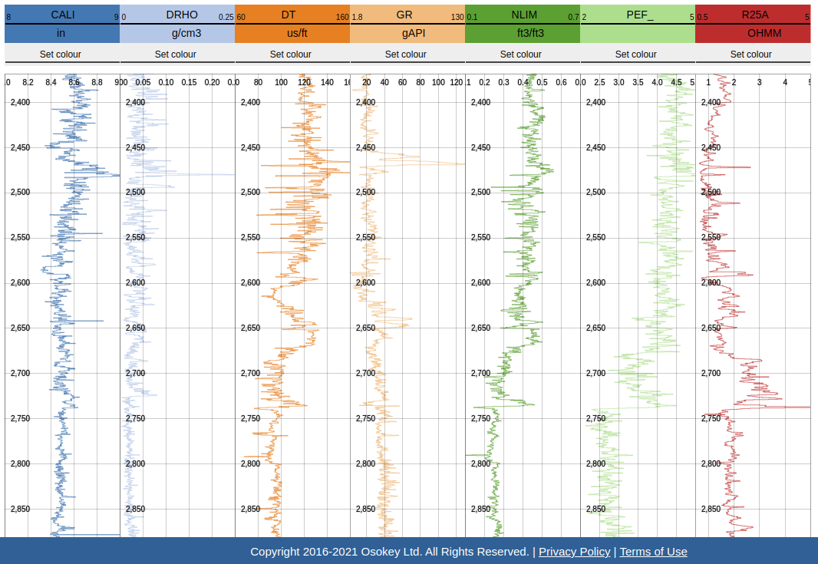
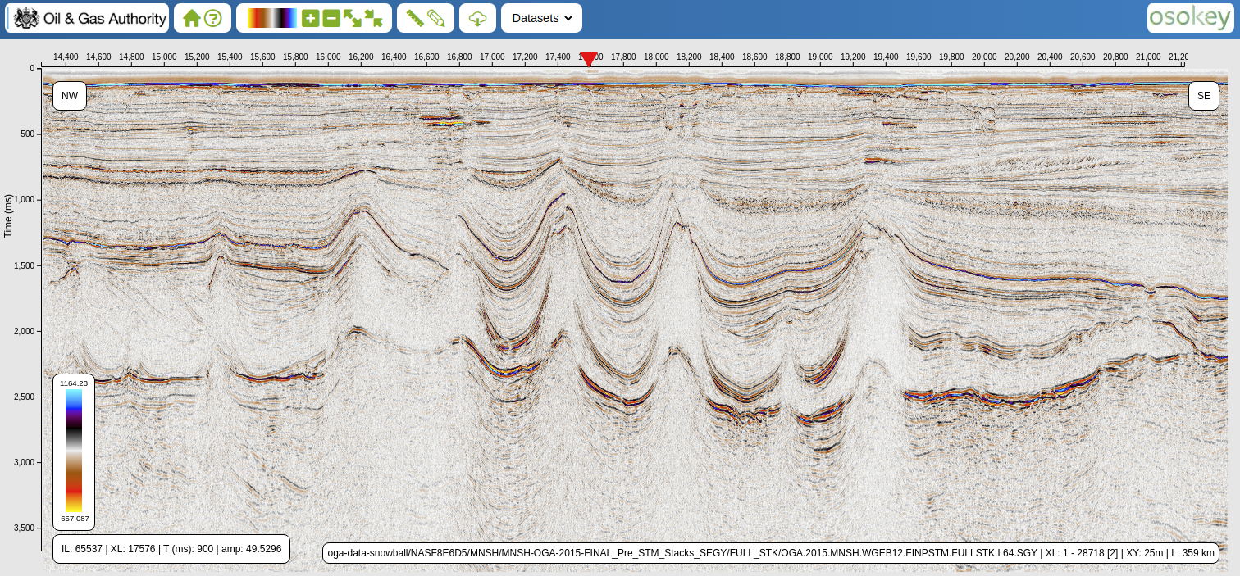
Meeting Restarts promptly at 11:00
NDR: A Digital Energy Platform component
All reported licence data in cloud storage
For all licence data, including legacy seismic
Reducing the barriers to reporting compliance
Investing in systems and controls to promote reuse of data
In-browser, pre-download visualisation of well and seismic datasets & reports
Self-service workflows for all
reporting and data access cases
Specialist data expertise Physical media delivery
Conditioning and enhancement of seismic
Delivering compliant, reportable and reusable data
Supercharged download as standard - by the Terabyte

Slide 23
Agenda: NDR User Group 2
Introduction - John Seabourn (OGA Chief Digital Officer) 5m
Compliance and data quality – David Lecore (Head of Data Services & Compliance) 10m
Transition Project Update – Andy Thompson (NDR Manager) 5m
A look at forthcoming functionality – Joseph Nicholson (Osokey) 20m
Short Break
NDR User FAQs Overview – Andy Thompson (NDR Manager) 40m
Open Q&A – Andy Thompson & Joseph Nicholson (Osokey) 20m

Slide 24
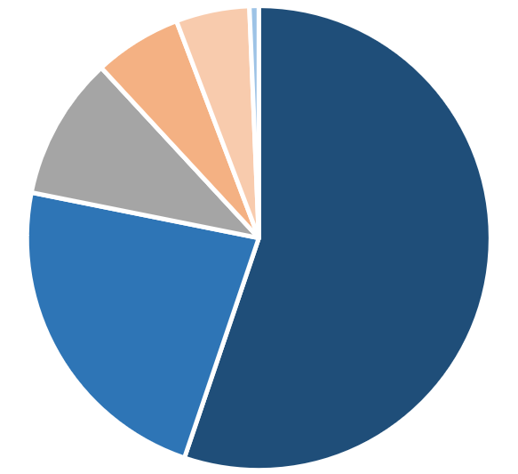
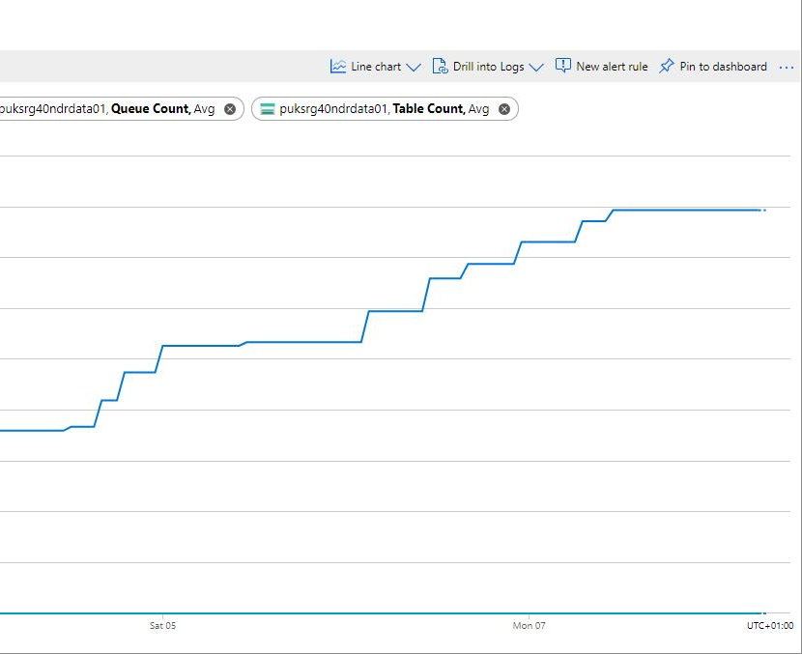
NDR User Questions and Answers
User Access to MVP
System Requirements
Data Transfer
Is there a launch date for licensees?
Will there be user testing of workflows?
How will users be onboarded/trained?
Will there be a “Beta” period?
Will there be a separate “Public launch”?
Will support be a person or automated ?
Do I need to install client apps?
Does Chromium browser mean Chrome?
Will SFTP be an option for downloads?
Can I only obtain data online?
External link: Chromium browsers explained
What data will be transferred?
Are non-disclosable items included?
Will OGA data packages transfer?
Will only compliant data be uploaded?
What is happening to physical media?
If in doubt… GIVE US A SHOUT!

Slide 25
NDR User Questions and Answers
Reporting & Quality Control
Reporting continued
Permanence & Retention
Do I need to report new data types?
Will CS8 remain and be maintained?
What quality criteria will be applicable?
How will non-compliance be handled?
Physical media – copies and returns?
What is meant by “elective” reporting?
NDR Form & Manner reference doc
What can I do to prep SNS well data?
Can I validate seismic headers before executing major uploads?
Can I mitigate failure of large uploads?
If there is no physical media archive in the NDR, can data owners similarly dispose of physical archives?
What happens to reported data?
Is NDR Cloud data storage resilient?
Do I have to retain data once reported?
Is data “decimated on upload/download?

Slide 26
NDR User Questions and Answers
Future “API” Services
Downloads and Limits
Feedback & Enhancement
Will the current API be reinstated?
Will web services play a role?
What form will this take in future?
Will content that is downloaded via API style connection register against my monthly allowance?
https://www.ogauthority.co.uk/data-centre/
What am I able to download?
Will there be a limit per “basket”?
Who is able to download?
Is there an “allow list”? Am I on it?
How do I “moderate” downloads?
Can I increase my allowance?
Is delivery on media an option?
General queries: ndr@ogauthority.co.uk
User Group – Feedback form
https://forms.office.com/r/E6ufMZcXat
Developments endorsed by DEP AC
Delivered by Task Finish Groups
Will you publish MVP & Roadmap spec?
Prioritised continuous improvement

Slide 27
NDR User Questions and Answers
Handling of Data
Entitlement to Data
Charges & Payments
Will conditioning of data be routine?
Will I be able to choose export format?
Can I report old data in old formats?
Can I report multiple records at once?
Decommissioning & COP related data?
Will entitlement to “protected information” be supported?
When will I be able to entitle partners?
Will it be as it was previously?
What will happen to current settings?
Which NDR aspects are chargeable?
How do I arrange chargeable services?
Who do I contract with and how?
Can we see a schedule of rates?
Do I need to pay up front?
Can I pay via PO & Invoice?
info@Osokey.com

Slide 28
Agenda: NDR User Group 2
Introduction - John Seabourn (OGA Chief Digital Officer)
Compliance and data quality – David Lecore (Head of Data Services & Compliance) 10m
Transition Project Update – Andy Thompson (NDR Manager) 5m
A look at forthcoming functionality – Joseph Nicholson (Osokey) 20m
Short Break
NDR User FAQs Overview – Andy Thompson (NDR Manager) 40m
Open Q&A – Andy Thompson & Joseph Nicholson (Osokey) 20m

Slide 29
Open Questions & Answers

Slide 30
What happens next?
User Group:
Subscribe to our User Group mailing list
Summary of feedback to this meeting to DEP AC
Outcome communicated to Mailing list subscribers
Onboarding - reach out to licensee representatives
NDR – OGA website: https://www.ogauthority.co.uk/data-centre/national-data-repository-ndr/
NDR Update - Mailing list subscriptions: https://forms.office.com/r/Y9ACJSd8n7
NDR User Group - Feedback, comments and questions: https://forms.office.com/r/E6ufMZcXat

Slide 31
Thank you
NDR – OGA website: https://www.ogauthority.co.uk/data-centre/national-data-repository-ndr/
NDR Update - Mailing list subscriptions: https://forms.office.com/r/Y9ACJSd8n7
NDR User Group - Feedback, comments and questions: https://forms.office.com/r/E6ufMZcXat

