Slide 1
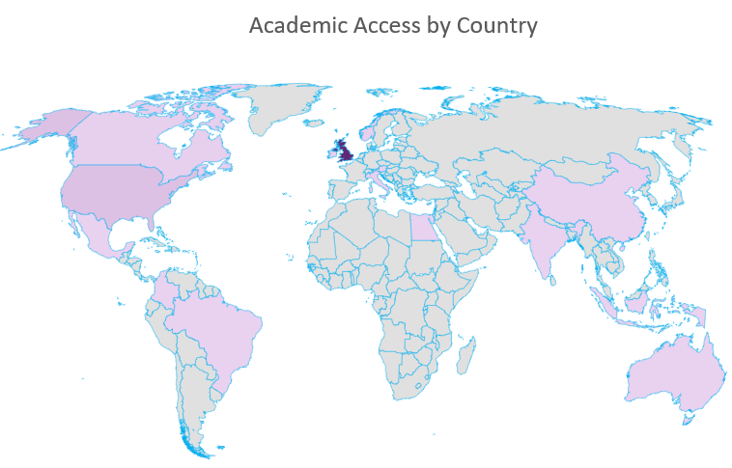
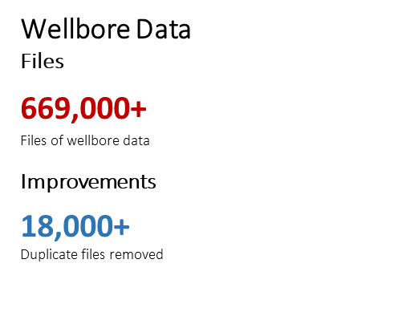
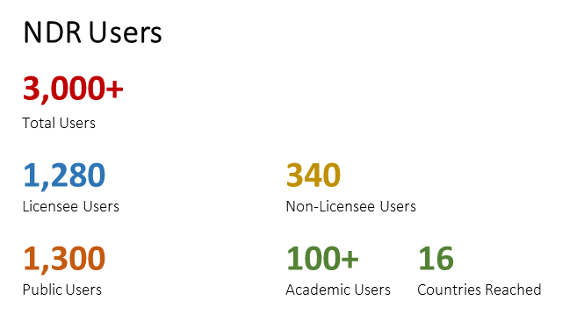
NDR Metrics

Slide 2
National Data Repository
User Group Meeting No. 4
1st March 2022
© OGA 2022
This presentation is for illustrative purposes only. The OGA makes no representations or warranties, express or implied, regarding the quality, completeness or accuracy of the information contained herein. All and any such responsibility and liability is expressly disclaimed. The OGA does not provide endorsements or investment recommendations. Oil and Gas Authority is a limited company registered in England and Wales with registered number 09666504 and VAT registered number 249433979. Our registered office is at 21 Bloomsbury Street, London, United Kingdom, WC1B 3HF

Slide 3
Meeting etiquette & structure
Please turn your cameras off and remain muted.
The meeting will be recorded. The presentation materials will be made available.
Please use the meeting chat to post your questions throughout the meeting.
There will be three sections to the meeting.
Questions raised in Chat will be addressed at the end of each section.
There are several topics and speakers today – we need to keep to time to cover all topics.
There may be time for discussion towards the end of the meeting.

Slide 4
Agenda
Introductory topics: (10:30)
Purpose and Objectives of the NDR (AT)
Data Reporting Formats & Quality Rules (AT)
Task Finish Groups: (10:55)
Completeness and Inventory - development overview (AT)
Missing Data Request – development overview (JN)
Web service access to NDR data/metadata (AT)
Entitlement to Protected Information (AT)
UI/UX Review (DH/MK)
Digital Advancement of the NDR: (11:30)
Unlocking value in offline archive (SC)
Proof of Concept - Conditioning legacy documents (Sword)
Classification of data – machine led tagging (DL)
Strategic outlook (AT/DS)

Slide 5
NDR Purpose and Objectives
The NDR addresses many industry and regulatory needs – including:
Ensuring global access to unique and irreplaceable petroleum-related information
Enabling the retention and reporting obligations of relevant persons to be discharged
Enabling the disclosure of petroleum-related information by the OGA
Ensuring that maximum value is derived from petroleum-related information by ensuring the widest possible transparent access
Ensuring the sustainable curation of petroleum-related information and samples
By ensuring that industry, academia and the wider public have ready access to timely and transparent data the OGA is creating the conditions for the investment and innovation necessary to support the OGA Strategy and to enable the Energy Transition.
global access
irreplaceable
reporting obligations
disclosure of petroleum-related information
maximum value is derived
sustainable curation
creating the conditions
investment and innovation
to support the OGA Strategy and to enable the Energy Transition.

Slide 6
NDR Transition Project - 2021
Suspension of survey loading
requiring tape transcription
or payment by invoice
Suspension of orders
payment by invoice
Suspension of loading
Credit card payment
Suspension of orders
Paid by credit card
OGA NDR Cloud Subscriptions commissioned
“Soft Freeze”
of changes to transferred data
“Hard Freeze”
of addition and changes to all data
*“Regulatory” functionality available to
authorised users
NDR Relaunched*
Agile enhancement dev & deployment
Dec
Jan
Feb
Mar
Apr
May
Jun
Jul
Aug
Sep
Continuous
Dev
NDR 2
Contract Signed
CDA Data Transfer Plan
Bulk Transfer
of NDR data & metadata starts
~26 TB
Delta Transfer of data & metadata
Original NDR Service ceased
Public Launch
Permanent removal of data from NDR 1
Ingress of ~95 TB OGA Gov Funded Seismic
Transfer of ~400 TB seismic field data on physical media

Slide 7
NDR Developments –
– August 2021
Support for
Non-seismic Geophysics
Support for
Field Info
Support for
Infrastructure Information
Support for
“Other”
Licence Info
Entitlements to Protected Information
Seismic Survey System of Record
Cloud to Cloud Reporting
Data Reporting & Collaboration
Wellbore SoR integration
User Edit to item metadata
Offline Data Ingress
“Delta” Online Data Migration
Data load to “ownerless” Project ID
Government Seismic Upload
Initial Configuration & Data Migration
Single File Download
Enhance search e.g. in file text
UX – review
Seis Summary
Cloud enabled ML workflows
Query save and share etc.
Interface Accessibility
Web Service data access
UX – review of
Well Summary
Data Accessibility
Data Completeness Management
Samples Catalogue Integration
Missing Data Request Mgt
Support for
CS Licence Data
Monitoring of compliance in data reporting
ISP enabling workflows
Review new inventories vs legacy settings
Monitoring of MDR responses
Compliance Management
Complete
In progress
Higher
Relative Priority
Lower
Not in progress

Slide 8
NDR Developments – September 2021
Support for
Non-seismic Geophysics
Support for
Field Info
Support for
Infrastructure Information
Support for
“Other”
Licence Info
Entitlements to Protected Information
Seismic Survey System of Record
Duplicates
Cloud to Cloud Reporting
Data Reporting & Collaboration
Wellbore SoR integration
User Edit to item metadata
Offline Data Ingress
“Delta” Online Data Migration
Data load to “ownerless” Project ID
Government Seismic Upload
Initial Configuration & Data Migration
Single File Download
Enhance search e.g. in file text
UX – review
Seis Summary
Cloud enabled ML workflows
Query save and share etc.
Interface Accessibility
Web Service data access
UX – review of
Well Summary
Data Accessibility
Data Completeness Management
Samples Catalogue Integration
Missing Data Request Mgt
Support for
CS Licence Data
Monitoring of compliance in data reporting
ISP enabling workflows
Review new inventories vs legacy settings
Monitoring of MDR responses
Compliance Management
Complete
In progress
Higher
Relative Priority
Lower
Not in progress

Slide 9
NDR Developments – November 2022
Support for
Non-seismic Geophysics
Support for
Field Info
Support for
Infrastructure Information
Support for
“Other”
Licence Info
Entitlements to Protected Information
Seismic Survey System of Record
Duplicates
Cloud to Cloud Reporting
Data Reporting & Collaboration
Wellbore SoR integration
User Edit to item metadata
Offline Data Ingress
“Delta” Online Data Migration
Data load to “ownerless” Project ID
Government Seismic Upload
Initial Configuration & Data Migration
Single File Download
Enhance search e.g. in file text
UX – review
Seis Summary
Cloud enabled ML workflows
Query save and share etc.
Interface Accessibility
Web Service data access
UX – review of
Well Summary
Data Accessibility
Data Completeness Management
Samples Catalogue Integration
Missing Data Request Mgt
Support for
CS Licence Data
Monitoring of compliance in data reporting
ISP enabling workflows
Review new inventories vs legacy settings
Monitoring of MDR responses
Compliance Management
Complete
In progress
Higher
Relative Priority
Lower
Not in progress

Slide 10
NDR Developments – January 2022
Support for
Non-seismic Geophysics
Support for
Field Info
Support for
Infrastructure Information
Support for
“Other”
Licence Info
Entitlements to Protected Information
Seismic Survey System of Record
Duplicates
Cloud to Cloud Reporting
Data Reporting & Collaboration
Wellbore SoR integration
User Edit to item metadata
Offline Data Ingress
“Delta” Online Data Migration
Data load to “ownerless” Project ID
Government Seismic Upload
Initial Configuration & Data Migration
Single File Download
Enhance search e.g. in file text
UX – review
Seis Summary
Cloud enabled ML workflows
Query save and share etc.
Interface Accessibility
Web Service data access
UX – review of
Well Summary
Data Accessibility
Data Completeness Management
Samples Catalogue Integration
Missing Data Request Mgt
Support for
CS Licence Data
Monitoring of compliance in data reporting
ISP enabling workflows
Review new inventories vs legacy settings
Monitoring of MDR responses
Compliance Management
Complete
In progress
Higher
Relative Priority
Lower
Not in progress

Slide 11
NDR Developments – March 2022
Support for
Non-seismic Geophysics
Support for
Field Info
Support for
Infrastructure Information
Support for
“Other”
Licence Info
Entitlements to Protected Information
Seismic Survey System of Record
Duplicates
Cloud to Cloud Reporting
Data Reporting & Collaboration
Wellbore SoR integration
User Edit to item metadata
Offline Data Ingress
“Delta” Online Data Migration
Data load to “ownerless” Project ID
Government Seismic Upload
Initial Configuration & Data Migration
Single File Download
Enhance search e.g. in file text
UX – review
Seis Summary
Cloud enabled ML workflows
Query save and share etc.
Interface Accessibility
Web Service data access
UX – review of
Well Summary
Data Accessibility
Data Completeness Management
Samples Catalogue Integration
Missing Data Request Mgt
Support for
CS Licence Data
Monitoring of compliance in data reporting
ISP enabling workflows
Review new inventories vs legacy settings
Monitoring of MDR responses
Compliance Management
Complete
In progress
Higher
Relative Priority
Lower
Not in progress

Slide 12
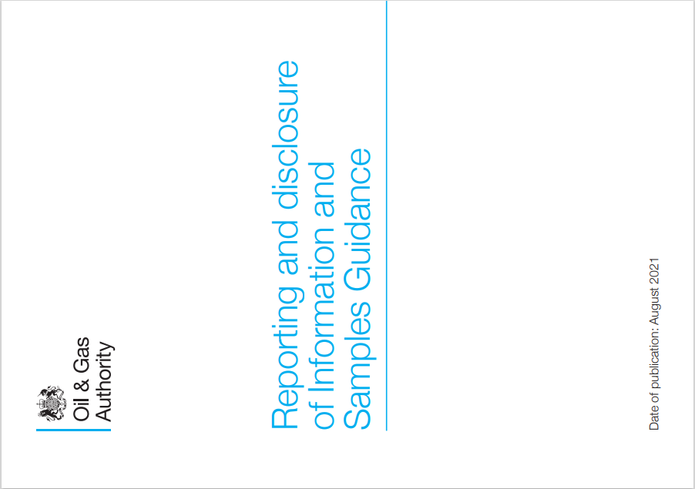
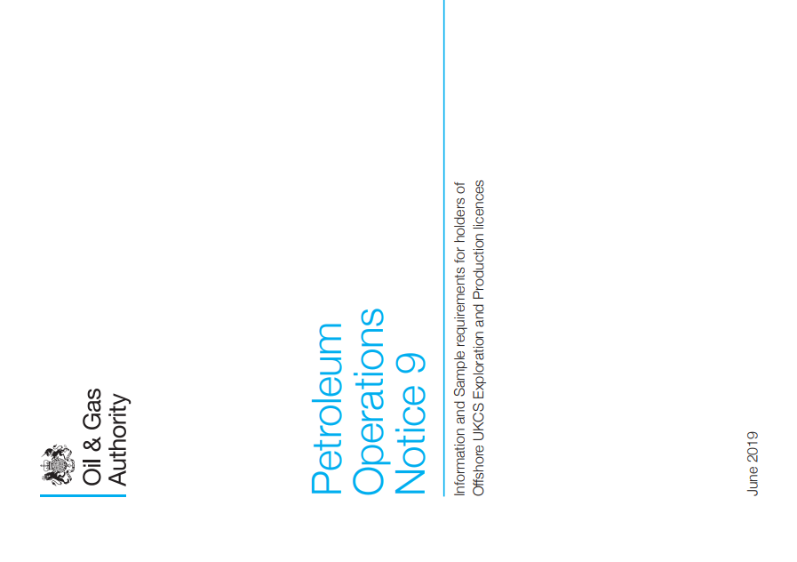
Reporting Formats & Quality Rules
Reporting Formats & Quality Rules
Reportable information is expected to be provided in standard formats.
Alignment of data to a standard “exchange format” is a fundamental principle of data management
There has always been a requirement to produce information in a usable format
For data to be considered to have been satisfactorily reported, it follows that we need to compare what has been submitted to the appropriate, published and maintained standard for the “exchange format”.
For the great majority of NDR information types the reporting formats have been required for several years – in some cases, for decades.
Legacy data is of variable quality – some good and some not so good.
We have all know this for some time. It was always intended that the new NDR would uphold standards in reported information. In order that data would be usable for all.

Slide 13
Reporting Formats - Examples
Reporting Formats - Examples
Information Type | Standard |  | Comment
Co-ordinate Ref Systems | UKOOA Guidance | 1999 | DTI statement of requirement
Reports/Documents | Machine readable PDF | 2006 | Digitalisation of UKCS has a dependency on digital information
Deviation Surveys | UKOOA P7/2000 | 2000 | Long standing expectation to align with a basic ASCII format
Digital Log Data | LAS or DLIS | 1998 | TIFF has not been an acceptable format for log data prior to the launch of the legacy NDR in 2019
Field Seismic | SEG-Y Nav-seis merge OR SEG-D rev 2.1 or above | Q1 2019 Then revised in Q3 2021 | Q1 2019 Guidance required SEG-D rev 3.1 This overly high standard has been revised to include earlier revisions Not aware of any challenges to rev 3.1 Earlier SEG-D formats are tape-native Digitalisation of the UKCS has a dependency on digital information
Processed Seismic | SEG-Y standards as defined by SEG standards committee | 2002 or earlier | Binary and trace headers as per SEG standard 2019 Guidance required rev 2 – we have proactively and pragmatically revised that
Seismic velocity data files | DISKOSV98 | Q3 2021 | Guidance previously required ESSOV2 format – however no definition of that has been found or produced.

Slide 14
Q&A
Introductory Topics

Slide 15
Task Finish Groups

Slide 16
NDR User Group ToR recap
Scope
All aspects of NDR functionality, including but not limited to:
Establishment of an enduring national archive of offshore petroleum related information
Fulfilment of industry obligations to report information to the OGA
The process of information disclosure of information
Data quality improvements and conditioning of data for reuse
Objectives
To create opportunities for users to collaborate on development and testing of services
To identify and propose solutions to resolve issues with functionality
To identify and propose solutions to issues with system usability and user awareness
To identify and characterise potential developments to existing functionality
To identify and characterise potential new functionality
Membership and Representation
Membership of the NDR User Group will be open to all registered users of the NDR, whether they represent a licensee, academia, other government and industry representatives or members of the wider public.
While all users will be welcome to participate in the activities of the group, for practical reasons meetings, events and associated task-finish groups may be limited to a maximum size, at the discretion of the OGA.
Membership of Task Finish Groups that arise from this User Group will be open to any user whose NDR user roles and business activities are relevant to the topic.
Each task finish group will report back to the NDR User Group with any outcomes.

Slide 17
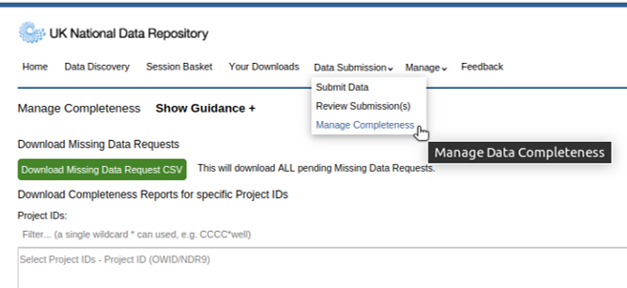
Completeness and Inventory
Since December, a Company Data Manager has been able to download Completeness Reports
Completeness Reports identify the information that has been reported via the NDR.
Having a more accurate understanding what is expected to be reported is beneficial to all users
The user can download a .csv file of metadata where their organisation has responsibility for reporting data
The metadata can be reviewed in a tool of their choosing – e.g. Excel or PowerBI
There are two files per Project ID – one is a summary of the Project ID including the Well ID/ Survey code, Release Date, and file count per Classification Tag
The second lists each file in the Project, including its unique file ID, file name, release date and Survey/Well ID

Slide 18
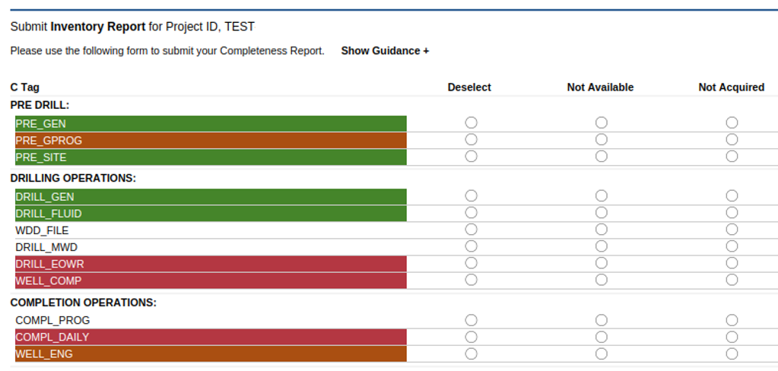
Completeness and Inventory
Inventory settings were migrated from the previous system – they have not been editable until now.
A Company Data Manager can maintain the Inventory for their company’s wellbore and survey information.
This includes recording that a certain data type has not been acquired, or that the information was acquired but it is not available to be reported to the OGA.
Marking a data type as "Not Acquired" or "Not Available“ launches a workflow in which the user can review and confirm their selections and provide supporting comments to inform themselves, subsequent users and the OGA.
The C Tag for a data type marked as “Not Acquired” will be coloured red, while data that is marked as “Not Available” will be coloured orange.
Where data has been loaded and classified, the associated C Tag will be coloured green – this means an item with that C Tag is present in the system. It does not mean that the reporting status is complete.

Slide 19
What happens to my Missing Data Request (MDR)?
Missing Data Request Management
User submits MDR
?
Petrovich9 / Getty Images/iStockphoto

Slide 20
MDR Workflow 1
User receives MDR Zendesk ticket
User submits MDR
OGA Review

Slide 21
MDR Workflow 2
User receives MDR Zendesk ticket closure when Data Reporting or Rejection occurs
User receives MDR Zendesk ticket
User submits MDR
Message rejecting request as lacking sufficient rationale
OGA Review
Requestor is required to provide information to support their request for data.
Users should not identify themselves within the free comment box.
Detail of what is required to be Reported by the licensee is helpful to the OGA Compliance Team.

Slide 22
MDR Workflow 3
User receives MDR Zendesk ticket closure when Data Reporting or Rejection occurs
User receives MDR Zendesk ticket
User submits MDR
Message rejecting request as lacking sufficient rationale
OGA Review
Company Admin / DM role holder CC’d on Zendesk ticket detailing MDR
Report Missing Data
ISC receives official email from OGA detailing MDR
Update Completeness Inventory with Not Available or Not Acquired
Company DM can also download .CSV of MDRs

Slide 23
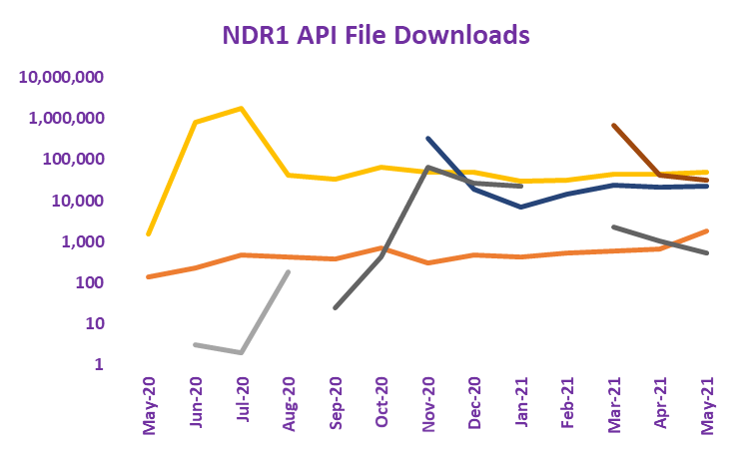
Web Service Access to Information
Accessing Information using Web Services:
Machine to machine connection that may facilitate the transfer of data and/or metadata
“Application Programming Interface” or “API”
Legacy NDR API: Developed in UKOilandGasData – prior to the upgrade to OGA’s Digital Services
Descoped from initial deployment
Reinstated – over a year later
Use cases varied significantly :
Data files and Documents – all files below 1 GB - generally well information
Metadata including: Licence boundaries, Well headers, Field boundaries – all derived from OGA Systems of Record
What problem are we addressing today? Metadata describing Completeness? Accessing all available content?
TFG003 – Web service access to the NDR: Tuesday 15 March Register your interest ndr@ogauthority.co.uk

Slide 24
Entitlement to Protected Information
Protected Information:
Reportable information that has yet to reach the date when the OGA may disclose it.
Also known as “Unreleased Data”
Entitlements:
A secure means of enabling another company to access protected information
406
58
Previously established as a means to share data within a licence group
Company A (usually the licence operator) would upload information – available to all Company A users
Company A would then grant entitlements to Company B – available to all Company B users (and C, and D etc.)
Context has changed: Activity levels - Availability of technology - Industry hub to NDR – Information security
What problem are we addressing today? Reimagine collaboration with protected information. For the future.
TFG004 – Entitlement to protected information: Monday 14 March Register your interest ndr@ogauthority.co.uk

Slide 25
Software services for public sector

Slide 26
introductions.
Dan Higgs
Head of Digital Products
Mariliis Kumnik
User Researcher
Notes:
DH
Head of Digital Products at Fivium
Fivium are software development company primarily working in the Government to Business space. Fivium have over 15 years of working closely with the OGA back to when they were part of the department of energy and climate change. This has been primarily focused on developing and supporting the digital services the OGA provide on the UK Energy Portal.
As well developing digital services for the OGA we also support them on user research and business analysis activities in relation to digital services.
With the recent release of the new NDR, OGA have asked us to carry out some end user research to understand how best to continue to develop and improve the service
Hand over to Mariliis to introduce and take you through what our plans are

Slide 27
NDR User Research Project.

Slide 28
What is user research and why is it important?
User research is the process of understanding the impact of design on an audience. It focuses on understanding user behaviors, needs, and motivations. It is important because it helps teams create services that meet users needs and work well for them.

Slide 29
Goals of this project.
Identify user needs, goals and pain points
Understand how users currently use the NDR service
Learn if the service meets the user' needs
Discover areas for improvements
Use user feedback to help prioritise work and make informed decisions

Slide 30
Help improve the NDR service.
Survey
We invite you to give feedback on the NDR service via a survey. Your feedback is greatly appreciated.
One-on-one user sessions
Let us know through the survey if you are interested to take part in further research to provide more detailed feedback.

Slide 31
Q&A
Task Finish Groups

Slide 32
Digital Advancement

Slide 33
Physical media to NDR
Moveout Data

Slide 34
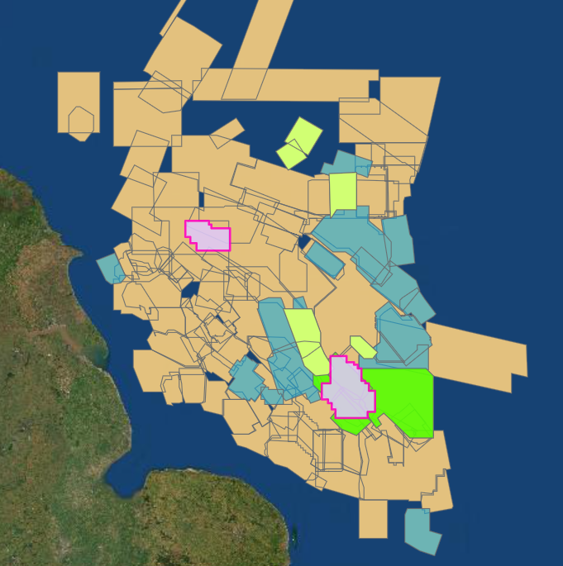
Field Data on NDR
Previously reported field data needs to be in better condition, made more accessible.
Physical media transfer included field data for…
66 x 3D surveys from 1978-2015
102 x 2D surveys from 1970-2015
NDR currently has field data for 79 x 3D surveys readily available for users to access
In excess of 40TB of field data has been uploaded in the last 8 months.
Field data previously reported are undergoing a systematic program of conditioning & upload
SNS 3D NDR Field Data
Beige = awaiting request
Blue = on tape / Moveout servers
Green = nav-merged & uploaded
Notes:
Nav-merges currently in the pipeline:
CNS = 21 Surveys, OMF = 6, SNS = 27, WOS = 10, Eng Chan= 1

Slide 35
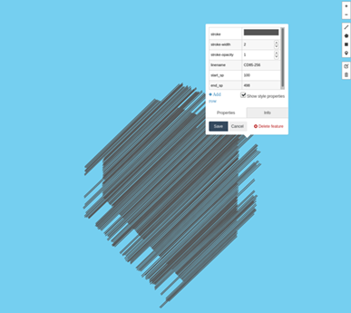
Data Conditioning
Data conditioning addresses existing data structure, format and navigation irregularities
Legacy field seismic is typically transcribed as a stream of tens of thousands of sequential SEG-D files:
Data required to be sorted into acquisition directories & each file within renamed with its associated FFID as written in the header.
missing data / anomalies now identified
Navigation P1 data are concatenated several sequences together into a single file and written in EBCDIC format:
Concatenated files are required to be split into individual acquisition sequences with correct corresponding header & reformatted to ASCII.
Shot points and timestamps from P1’s can be crosschecked with SEG-D files for each line ensuring we have all the correct data
Notes:
95% of field data previously reported do not meet current standards - Moveout are here to help. Typical examples include:

Slide 36
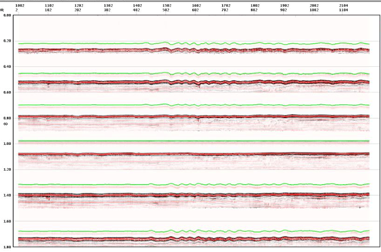
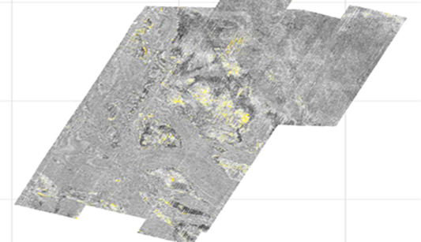
Nav-Merge Value
Nav-merge is a universal data processing step - it only needs doing once (correctly!)
Seismic and associated Navigation data locked together, losing either renders data worthless.
Data in ‘processing ready’ state, duplication of effort removed
Confirmation SEG-D & P1 data belong to the survey and each other and all expected data are present and correct.
Highlights errors in transcription, incorrect tape labels, missing data, corrupted files
Fixes can be applied in a timely manner whilst expertise is readily available
Homogenous format throughout the NDR.
Vastly reduced number of individual files per survey (millions to hundreds)
Mitigation of data loss, ready for machine learning / future tech

Slide 37
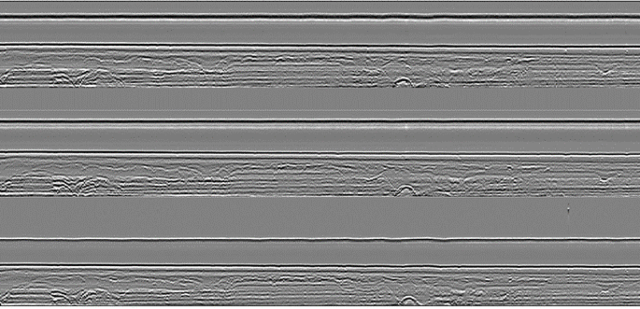
Here to help
Please use the Support Desk and access Moveout’s expertise
Accessible field data volume in the NDR is growing all the time
For assistance with any physical media data upload to NDR
Nav-merge, data reformat, standardisation and conditioning
Navigation processing / reprocessing / transformation
https://support.uk-ndr.co.uk
Problematic Nav-Merge fixed by Moveout
Top = LMO of original merge (3 streamers, 1 seq)
Bottom = Moveout fix same data

Slide 38
Date: 1 March 2020 | Nick Fosbery
NDR User Group
Machine Readable PDF conversion

Slide 39
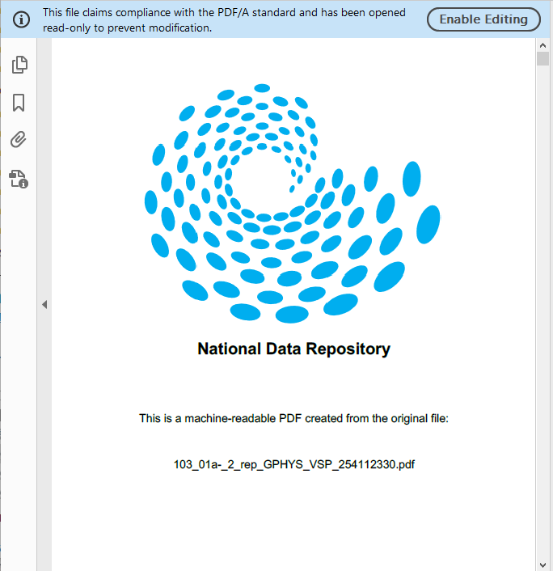
Bulk OCR of NDR Files
Improved Data Accessibility – Legacy File Conditioning
Background:
Large number of files are not machine-readable necessitating download and conversion by users
OGA Requirement:
Initial request for approx. 27,000 PDF files to be converted to machine readable PDF/A
Technical Solution:
Commercial off the shelf software for bulk conversion/OCRing of files
Deployed on high-spec Azure Virtual Machine
Software licensed to use all 4 cores to maximize throughput
Internal fast SSD storage for processing
Data is processed in batches – sourced from USB of NDR data + downloads
Multi-page TIF files excluded from request –
software can convert tiff, msg, doc*, ppt* etc. to PDF.
Low level of user interaction once the workflow is set up and running
As a rough guide, the software can process 1,000 pages per hour per CPU core

Slide 40
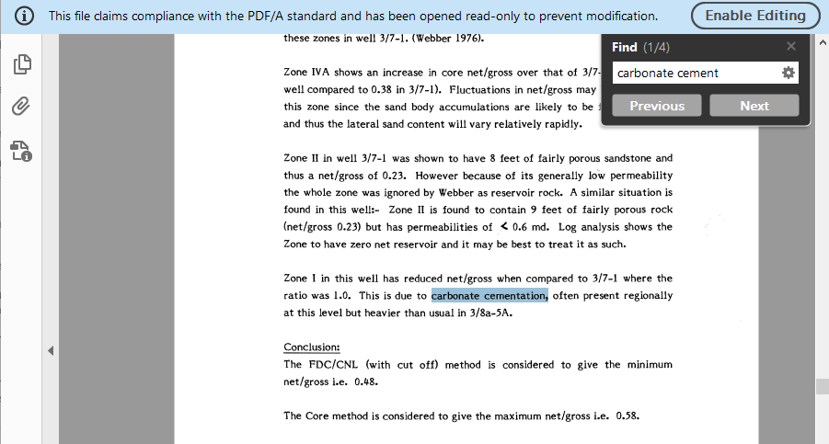
Results and Outputs
Outputs:
Cover page added with name of original source file onto converted file – text searchable.
Identification of corrupted files that could not be processed (0.13%) – and files that remained as an image PDF (no text could be extracted)
27,387 converted files delivered back to OGA Dec. 2021
Increased value and usability of text searchable files
OCR engines are continually improving their accuracy - better quality extraction on poorer quality source files

Slide 41
Improving Classification of Data
The OGA is planning a significant expansion of the available C-Tags (and M-Tags / Product Types)
We consider the existing C-Tags ‘not fit for purpose’
Expanding the C-Tags will help with:
Inventory Management and hence Compliance Management (data owners)
Compliance Measurement (OGA)
Ability to find information (All users)
Reduction in MDRs, as loaded data will not be requested (All users)
Work has commenced and is at an advanced stage
~40 new tags (wellbore data) are being ‘proposed’ + the renaming of others to make them more logical
Industry validation will be requested
A number of decision points exist
The plan is to have the tags applied by machine (not humans) – the ‘machine’ will read file content
They will ‘likely’ compliment the existing tags – i.e. being a secondary set (not replacing or adding to)
We are not specifying when – just saying this is on the cards

Slide 42
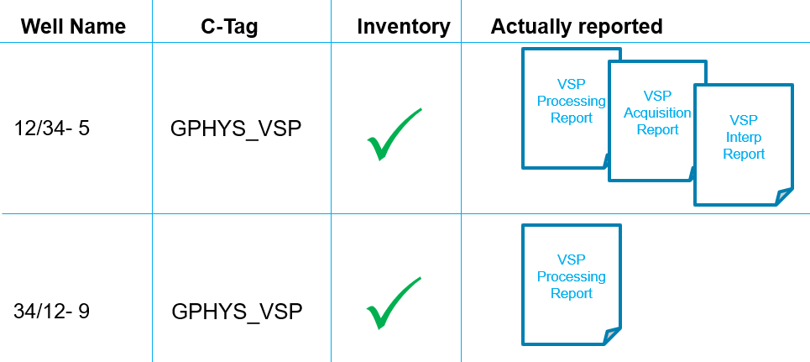
Improving Classification of Data
The primary flaw with the existing C-tags is they are not granular enough to satisfy Compliance Measurement, Inventory Management etc.
With current disclosure being triggered from ‘reported date’ means a user may wait ~2 years to access the Interpretation report, only to find it is a Processing report and would need to wait a further 2 years once the Interpretation report was loaded before it was disclosed

Slide 43
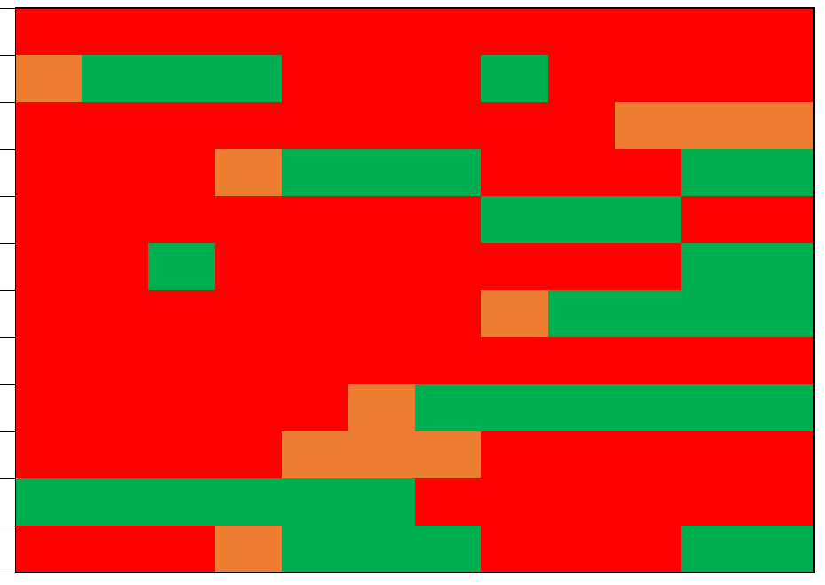
Improving Inventory Settings
In the past, the use of ‘Not Acquired’ tag in the inventory had been misused
Inconsistent / inaccurate use of tags by ‘some’ has spoiled for ‘everyone’, what could have been a useful tool
Coupled with the lack of granularity of the C-Tags means the broad requirement for all (data owners / OGA / users) to manage compliance / understand completeness, is not as effective as it could / should be
I feel for ‘example people’ 1 to 5 in the chart opposite
The old inventory data ‘will’ be in the new NDR inventory
This is a heads up from me on the quality of much of that inventory data
Time
Company A
Company B
2
Company C
Company D
2
1
Company E
2
Company F
2
Company G
3
Company H
Company I
4
Company J
Company K
4
Company L
5

Slide 44
NDR Developments – 2022 23
NDR Developments –
– 2022/23
Support for
Non-seismic Geophysics
Support for
Field Info
Support for
Infrastructure Information
Support for
“Other”
Licence Info
Entitlements to Protected Information
Seismic Survey System of Record
Duplicates
Cloud to Cloud Reporting
Data Reporting & Collaboration
Wellbore SoR integration
User Edit to item metadata
Offline Data Ingress
“Delta” Online Data Migration
Data load to “ownerless” Project ID
Government Seismic Upload
Initial Configuration & Data Migration
Single File Download
Enhance search e.g. in file text
UX – review
Seis Summary
Cloud enabled ML workflows
Query save and share etc.
Interface Accessibility
Web Service data access
UX – review of
Well Summary
Data Accessibility
Data Completeness Management
Samples Catalogue Integration
Missing Data Request Mgt
Support for
CS Licence Data
Monitoring of compliance in data reporting
ISP enabling workflows
Review new inventories vs legacy settings
Monitoring of MDR responses
Compliance Management
Complete
In progress
Higher
Relative Priority
Lower
Not in progress

Slide 45
Strategic Outlook
Develop interface & workflows - improved accessibility
- what challenges are there to reporting and accessing data?
Data and Metadata Improvement - upgrading or formatting legacy reported content
- automated classification - leading to better search results
More data – further reduction of obstacles to reporting. Facilitate relief of obligations to retain data
Integration with other systems – Wider OGA Digital Energy Platform, BGS Core repository, TCE/CES
For strategic purposes – making sure the standard of content is up to the demands of Digitalisation
Digital content & unlimited resources - imagine the possibilities….

Slide 46
Q&A
Digital Advancement

Slide 47
Dates For Your Diary
Date | Meeting/event information
March 2022 | Monday 14th March – TFG004: Entitlements to Protected Information Tuesday 15th March – TFG003: Web service access to the NDR Date to be confirmed – TFG005: UI/UX Review
May 2022 | Tuesday 31st May – NDR User Group Meeting 5
August 2022 | Tuesday 30th August*– NDR User Group Meeting 6
November 2022 | Tuesday 29th November* – NDR User Group Meeting 7
*Provisional date

Slide 48
Thank you

