Slide 1
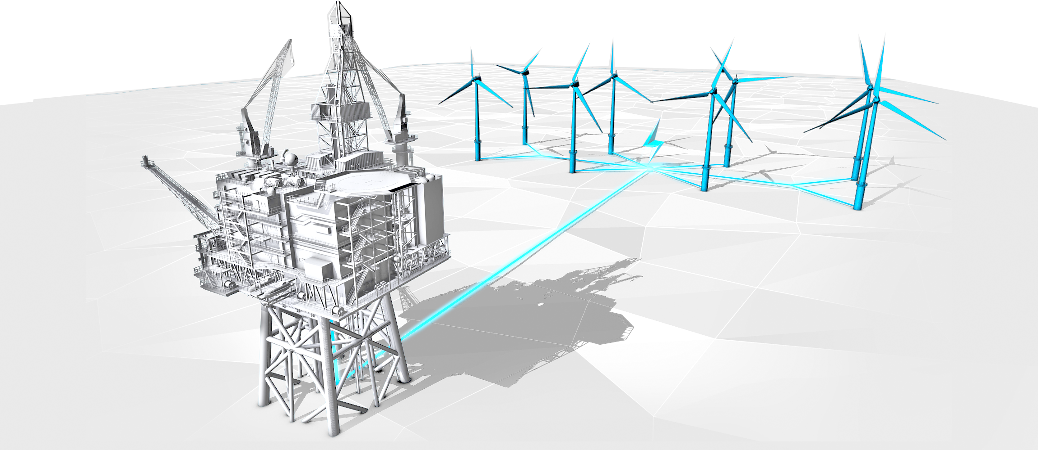
Aberdeen – Energy City
Regulating for a future North Sea
Stuart Payne, Chief Executive
21 May 2024

Slide 2
Aberdeen – Energy City

Slide 3
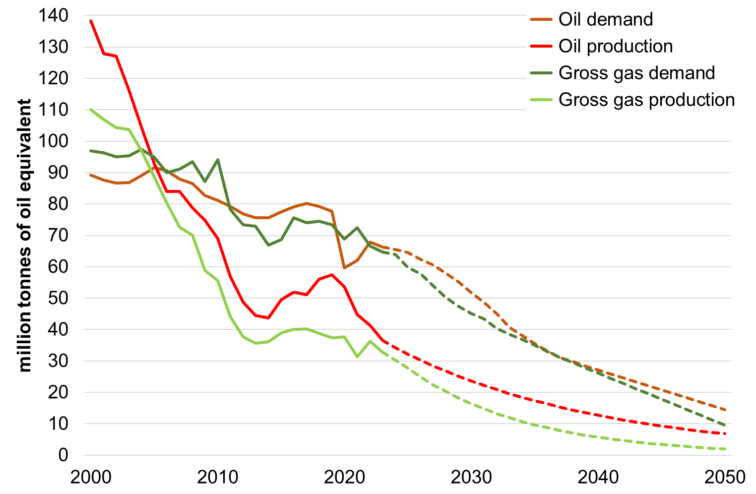
North Sea – Current Context
UK oil and gas production forecast to decline faster than net zero demand pathways
~75% of total UK energy needs met by oil and gas
40% share of UK gas demand met by domestic production
UK forecast to be a net importer out to 2050

Slide 4
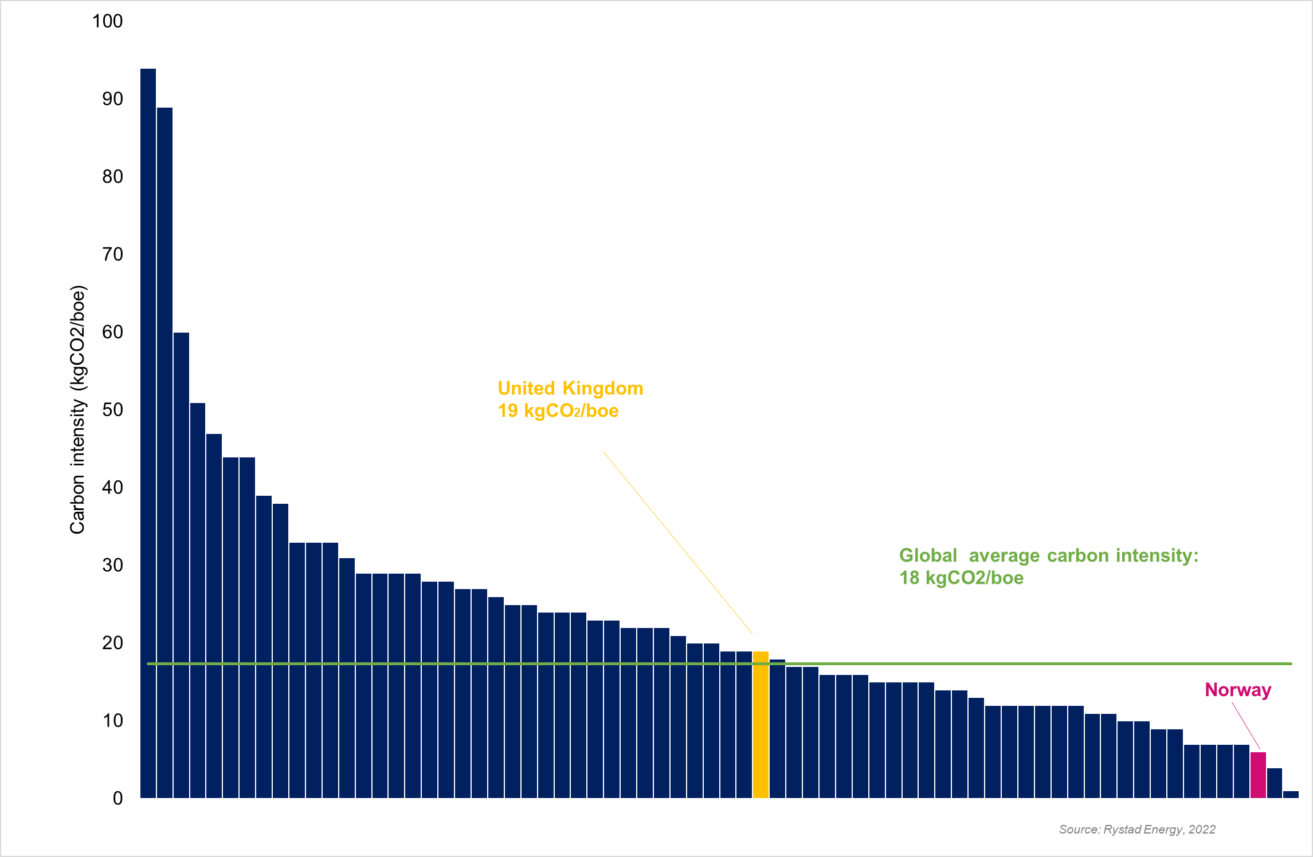
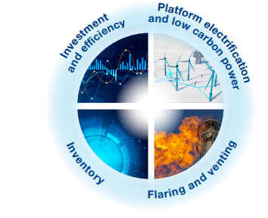
Decarbonising domestic production
UKCS carbon intensity compared with other countries
New NSTA Emissions Reduction Plan to drive down UKCS emissions

Slide 5
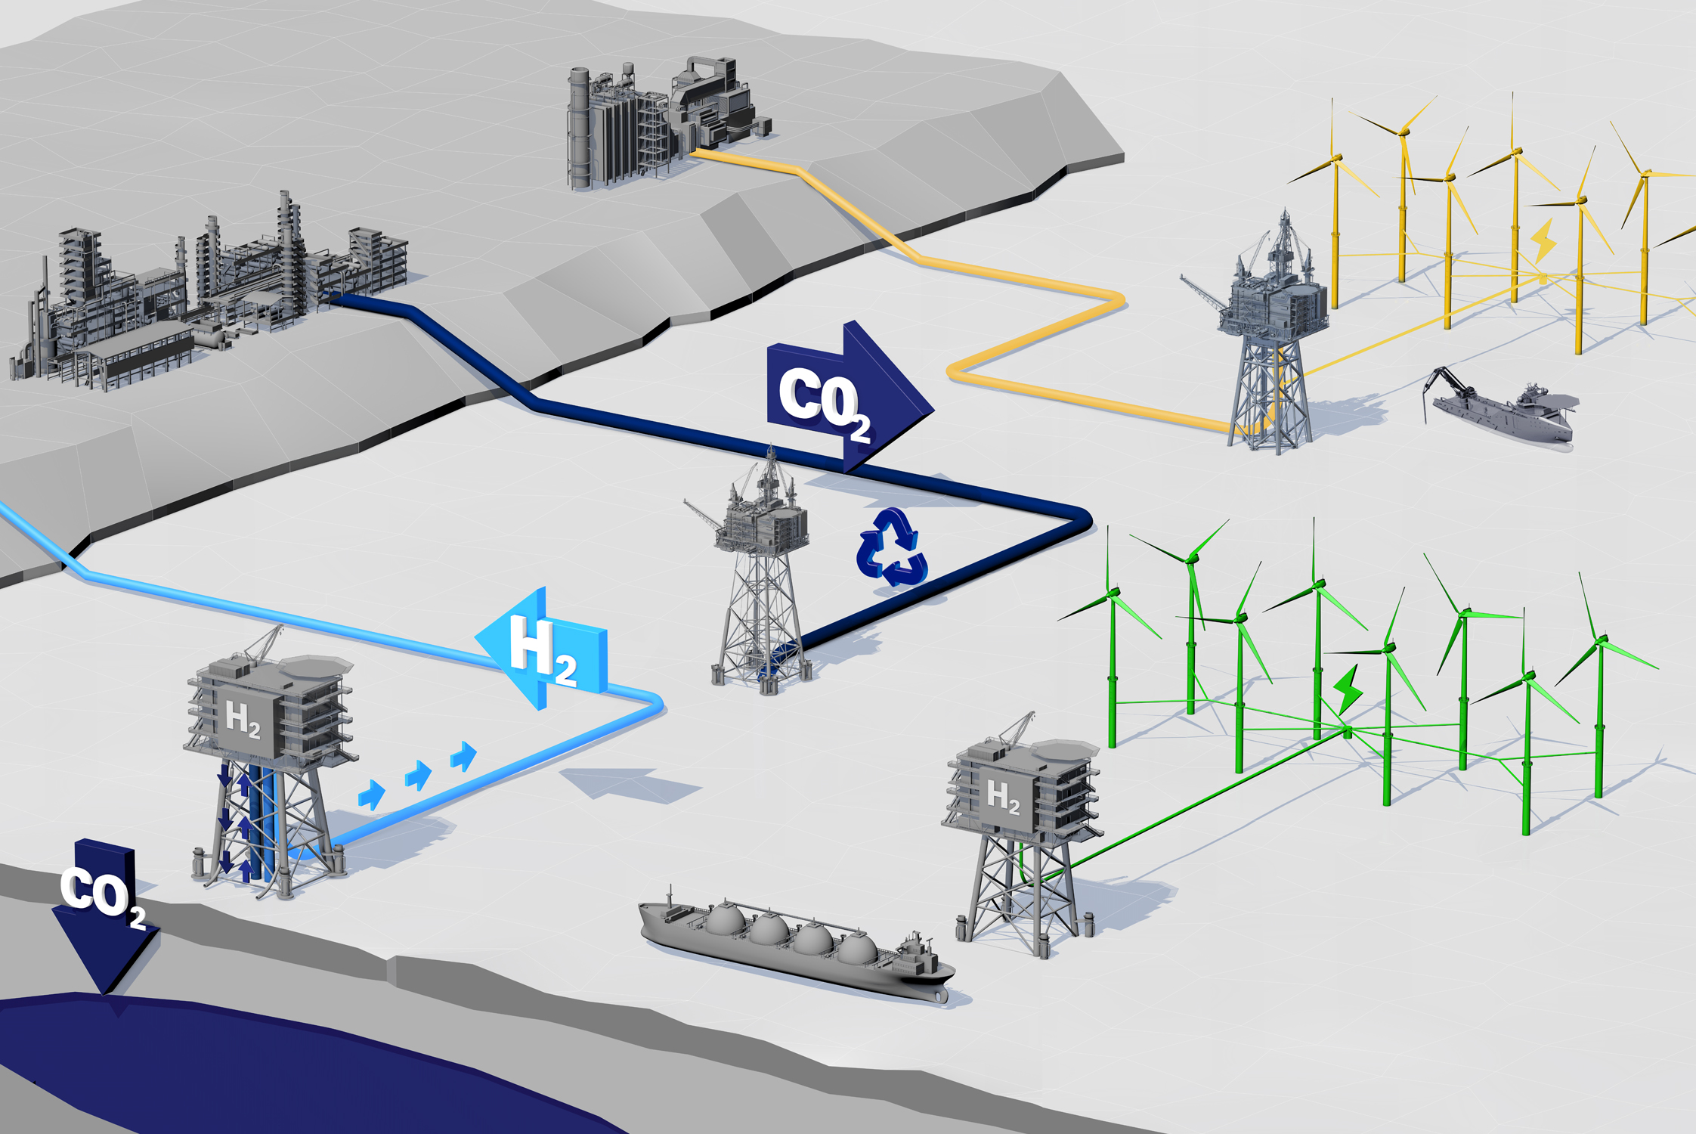
Secure supply of ~5bnboe
Reduce emissions by up to 25MtCO2e
Anchor jobs and supply chain for transition

Slide 6
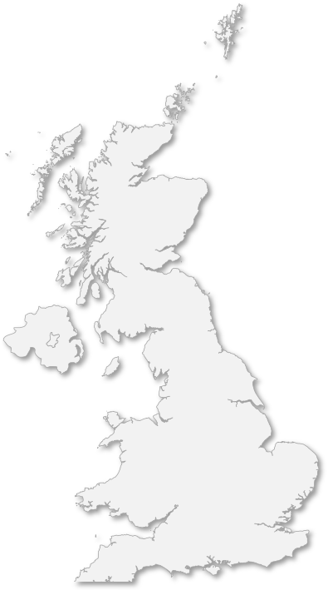




Integrated energy hubs
Sullom Voe
50GW fixed & floating offshore wind
Flotta
78GT CO2 storage potential
St. Fergus
10GW low carbon hydrogen target
Teesside
Humber
100+ pipelines with repurposing potential
Morecambe
Hynet
Theddlethorp
Bacton
60%
of UK’s abatement¹

Slide 7

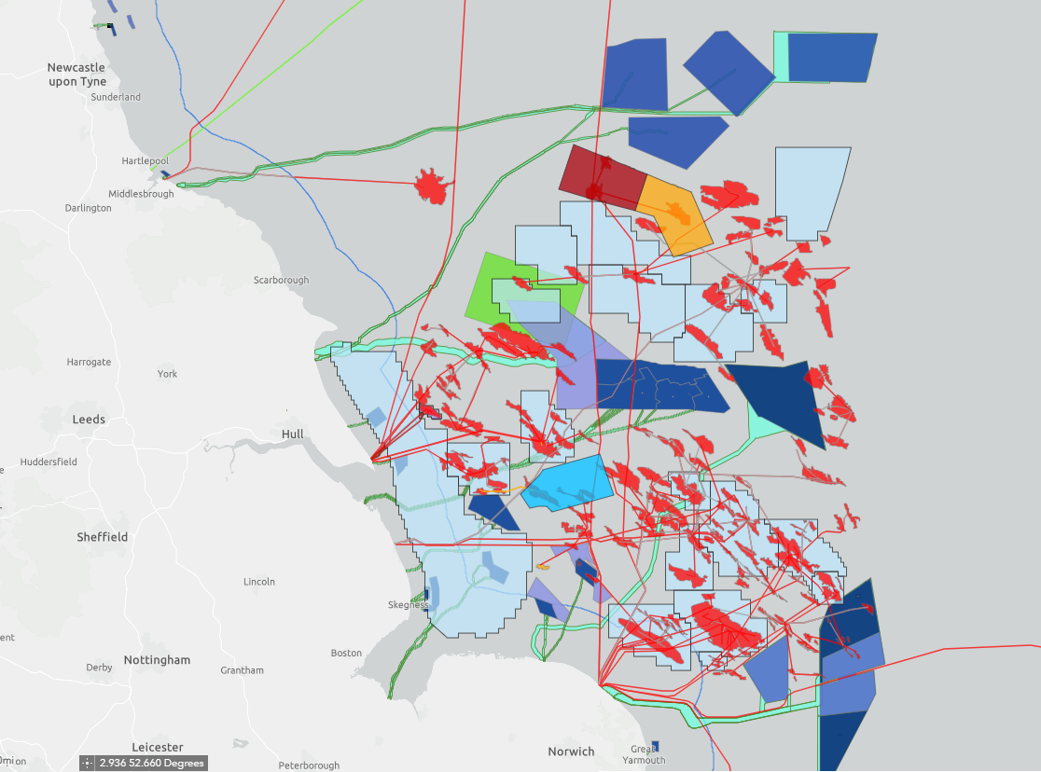
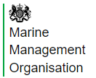










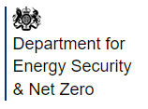
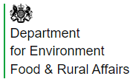



The Offshore Energy Rubik’s Cube
Gas fields
Carbon storage licences
Cable agreements
Carbon storage leases
Offshore wind sites
Notes:
Map shows the energy users in SNS – gas, wind, ccs and their associated transport infrastructure like cables and pipelines.
On top of this are other marine users such as fishing, defence, shipping and marine habitats.
The CCS licensing round (and petroleum rounds) required considerable consultation and collaboration with other agencies to understand these overlaps.
Regulatory approvals are needed from a variety of organisations however there is opportunity here to repurpose existing infrastructure.

Slide 8
Aberdeen – Energy City

